Slide 1
人工智能引论
宋睿华
中国人民大学人工智能学院

Slide 2
人工智能与听觉
语音基础
主要任务与基础方法
语音识别
音色转换
说话人分离
语音合成

Slide 3
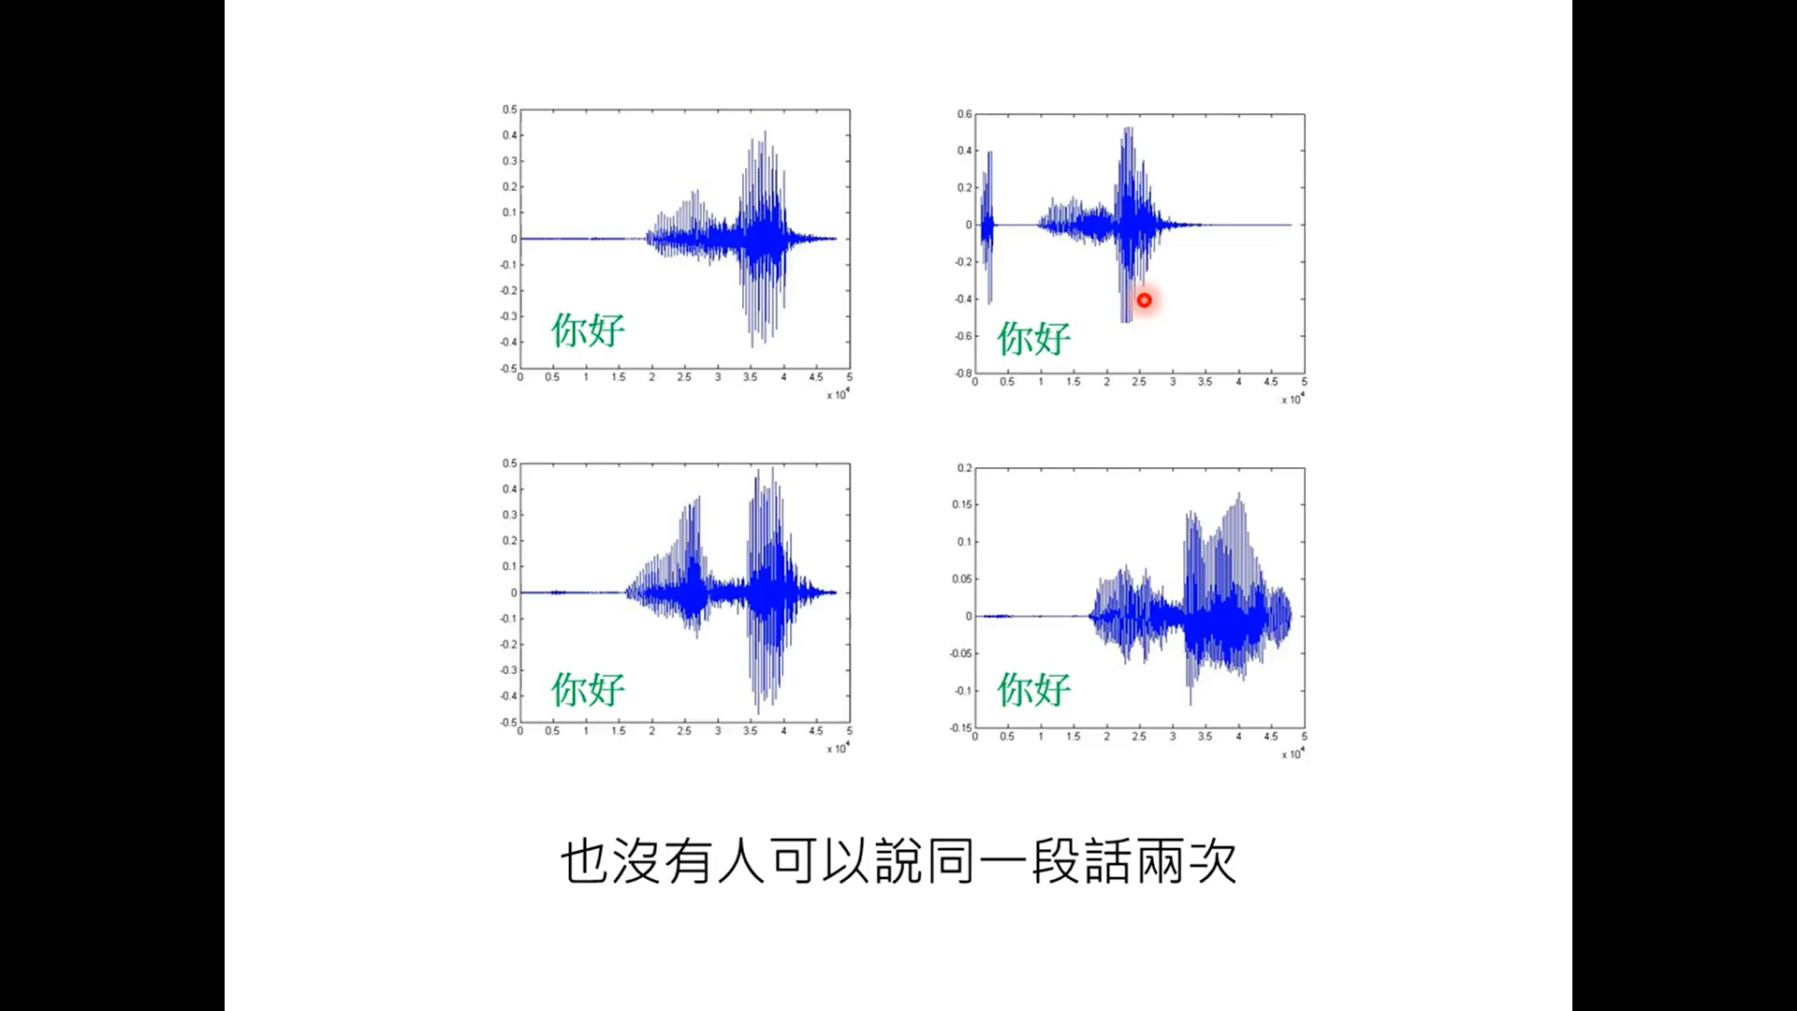

Slide 4
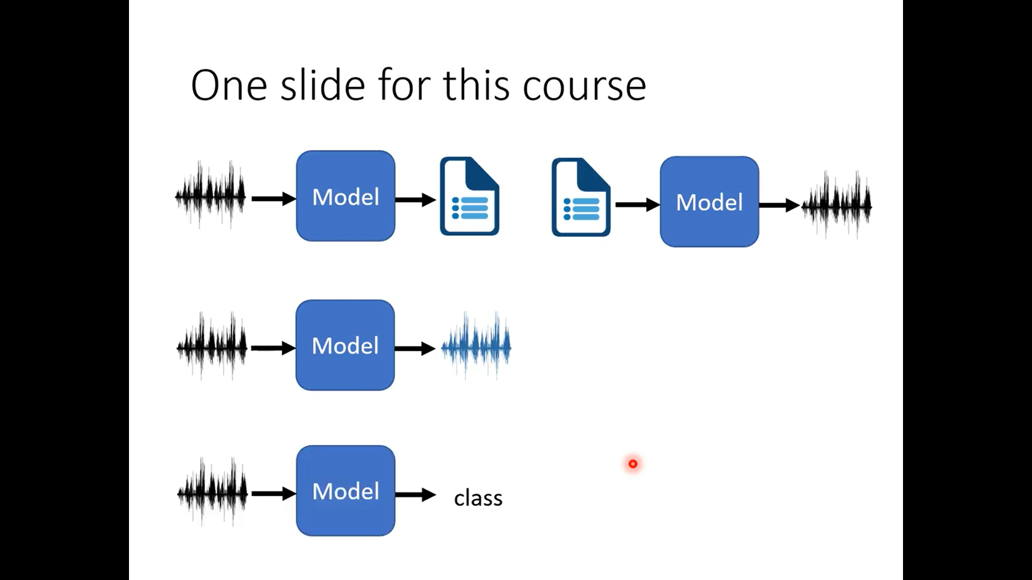

Slide 6
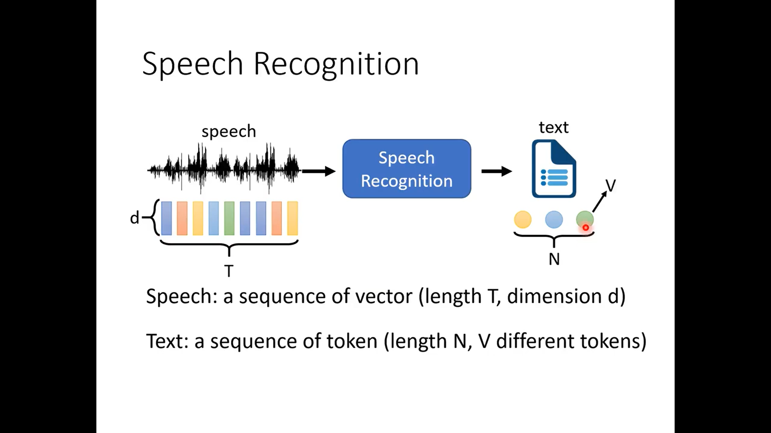

Slide 7
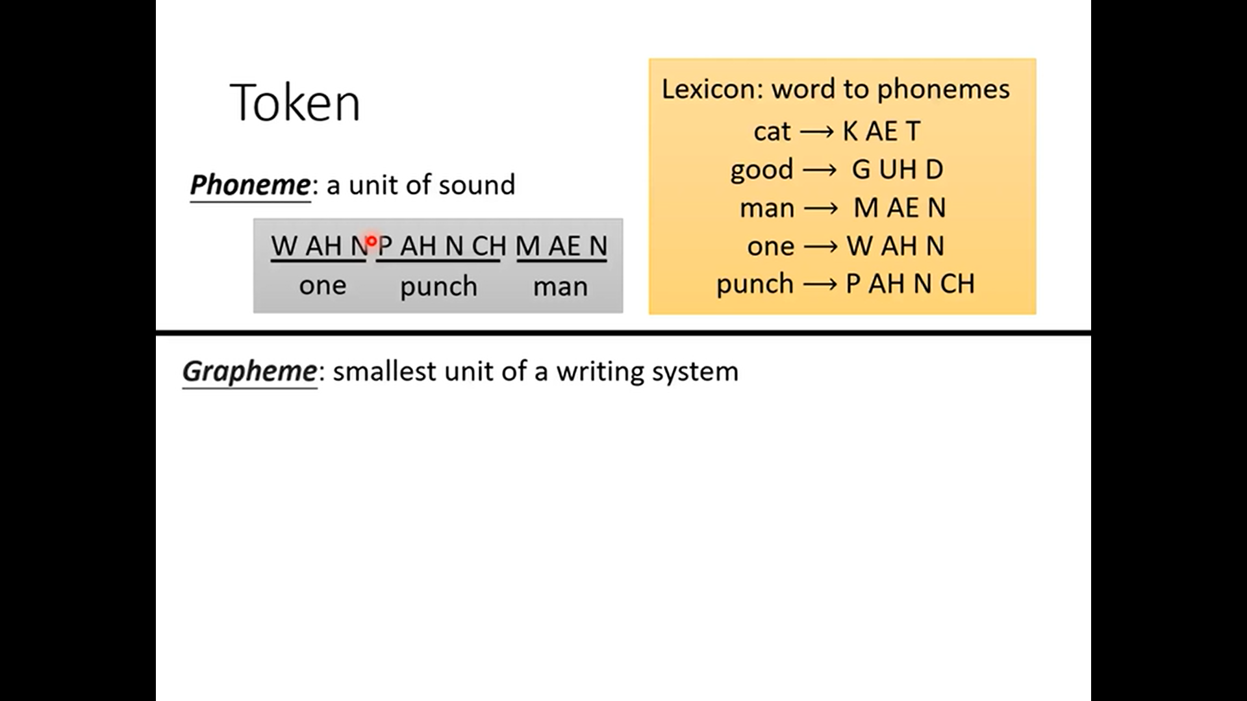

Slide 8
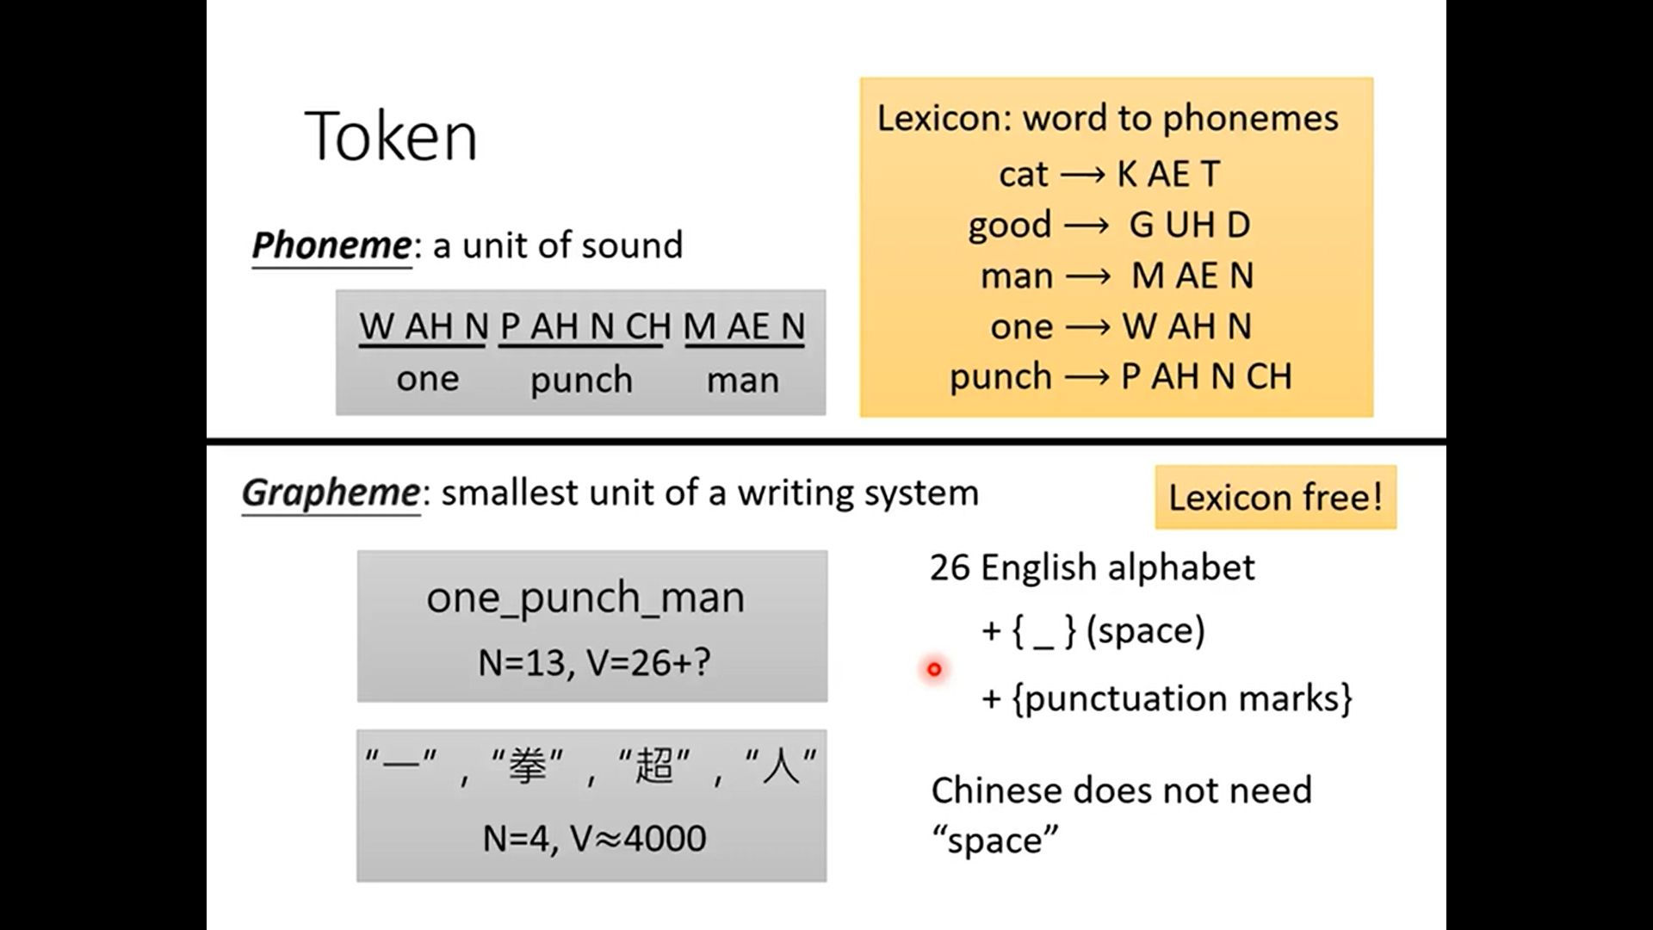

Slide 9
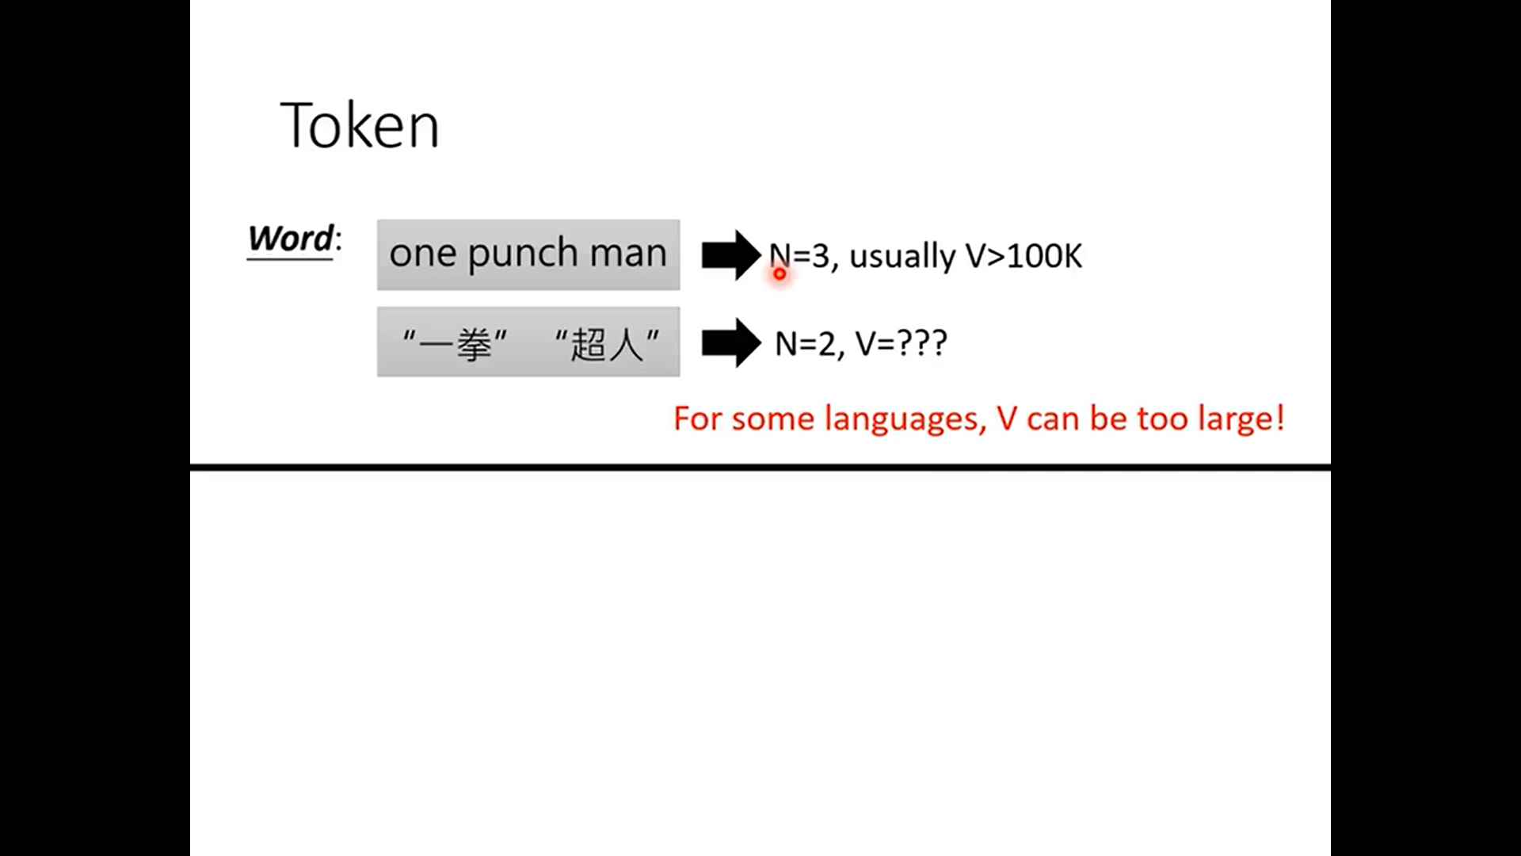

Slide 10
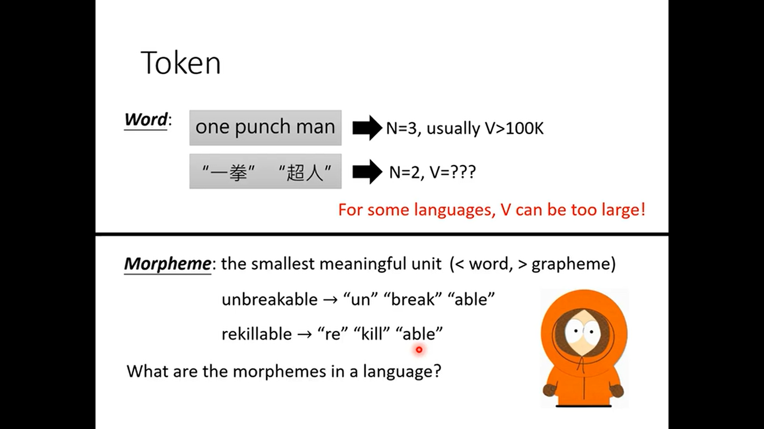

Slide 11
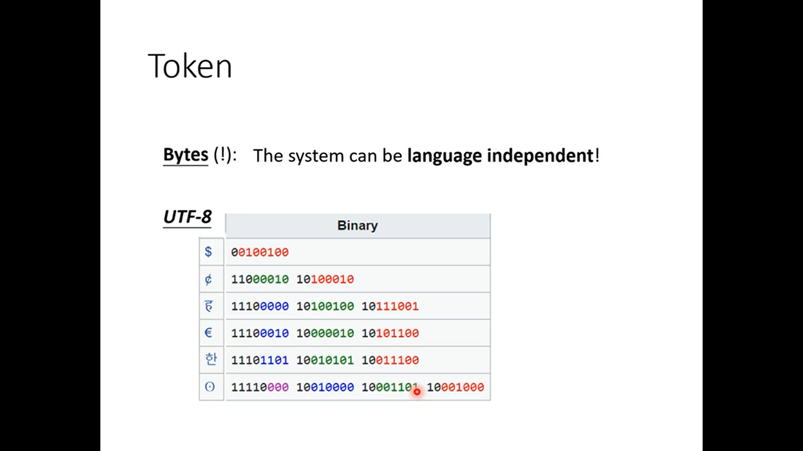

Slide 12
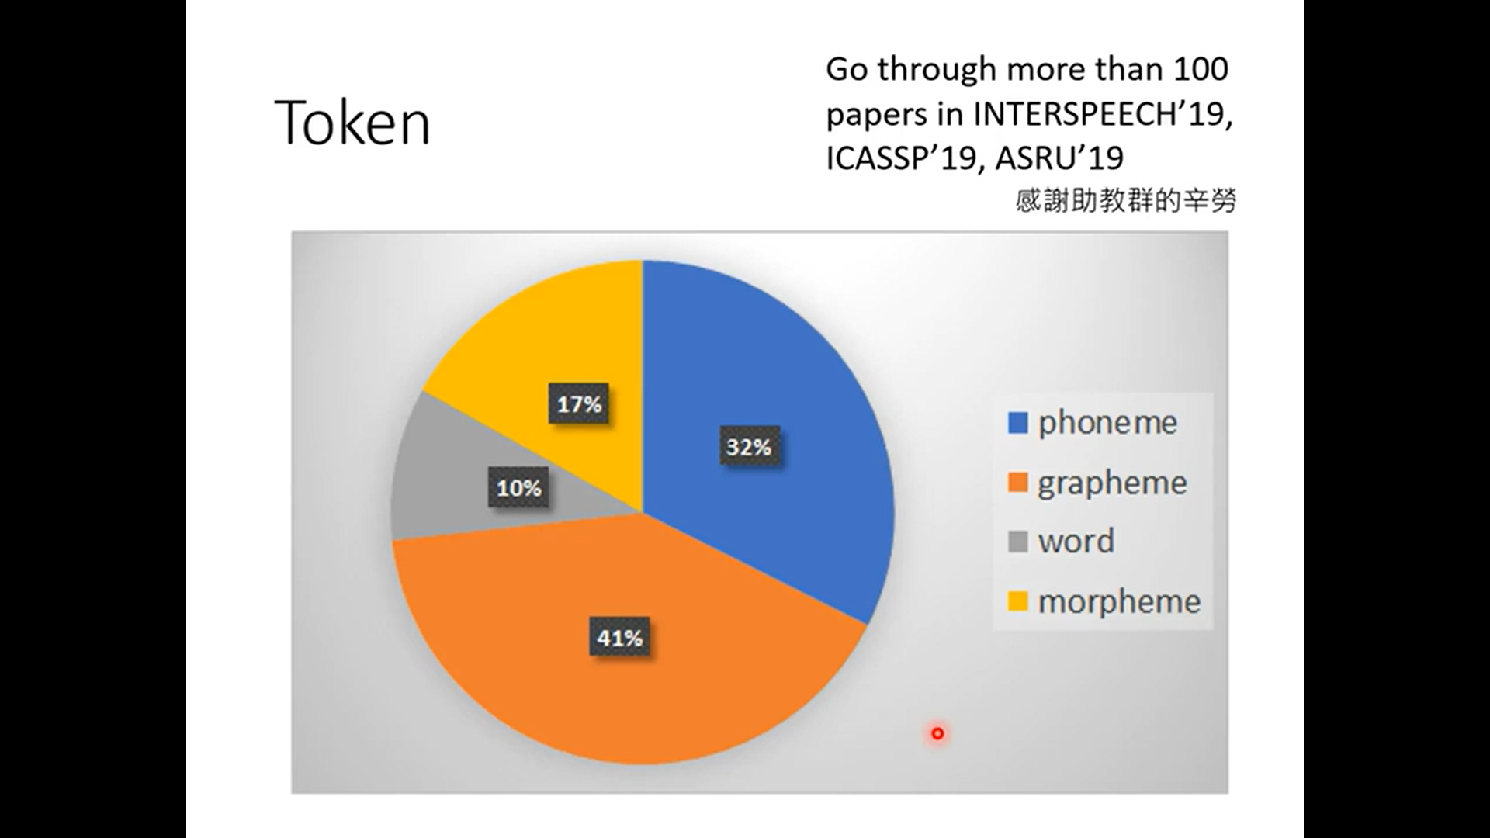

Slide 13
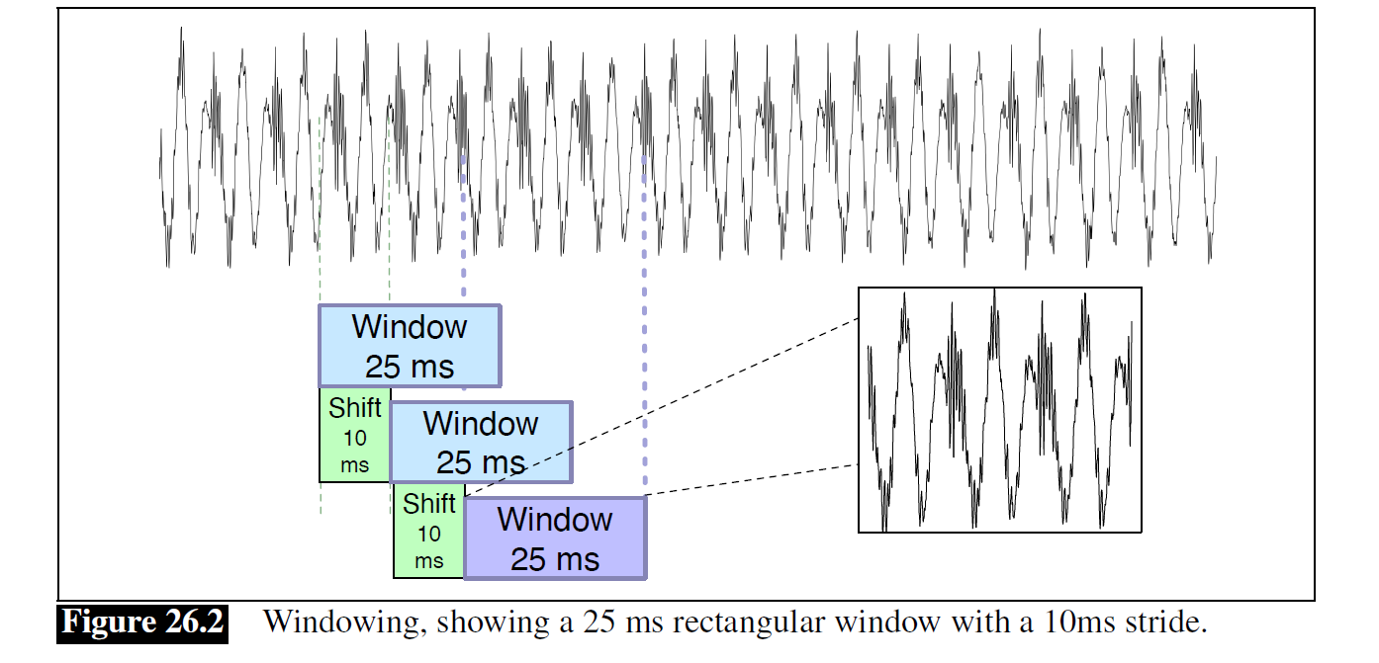
Frame or Window

Slide 14
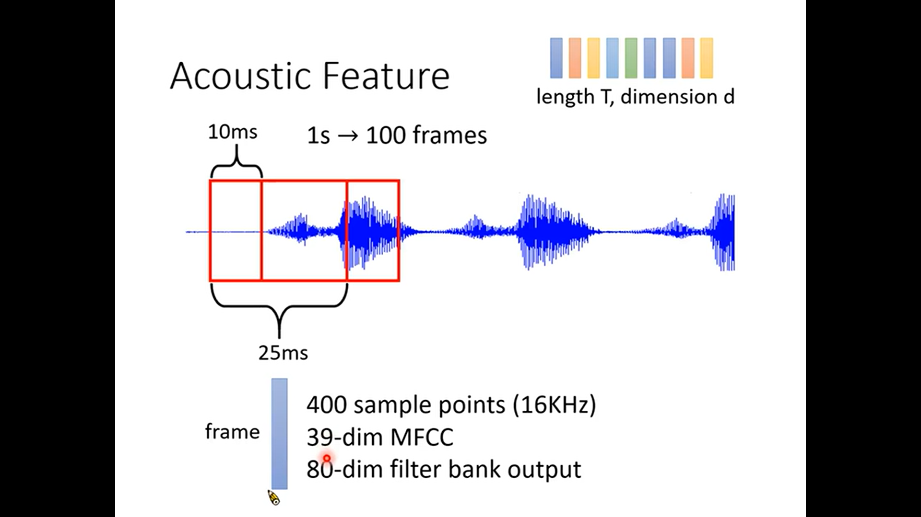

Slide 15
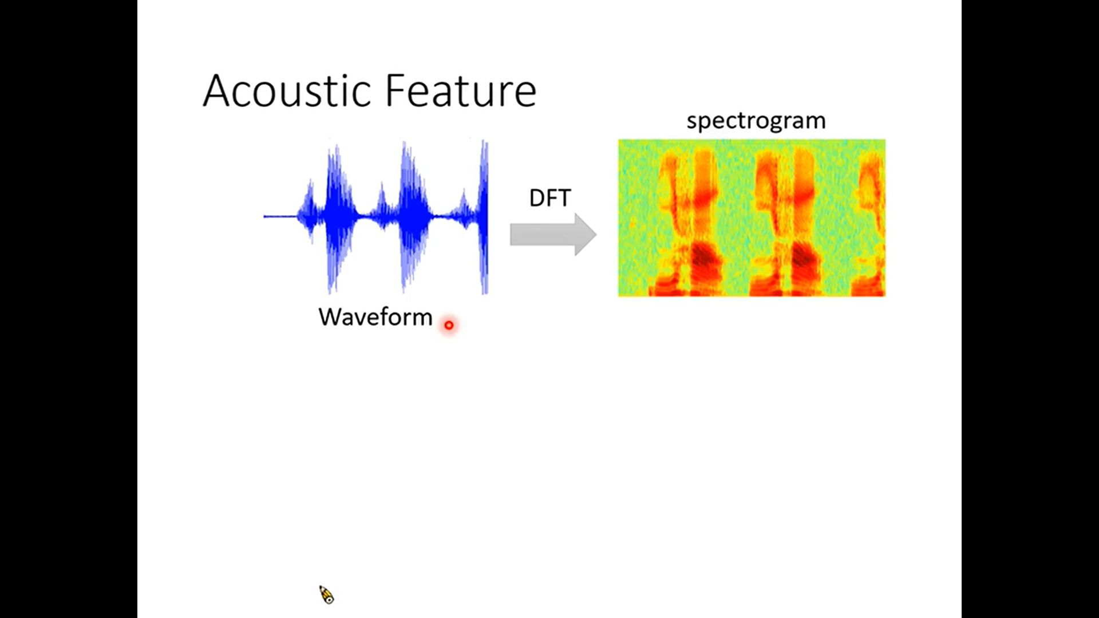

Slide 16
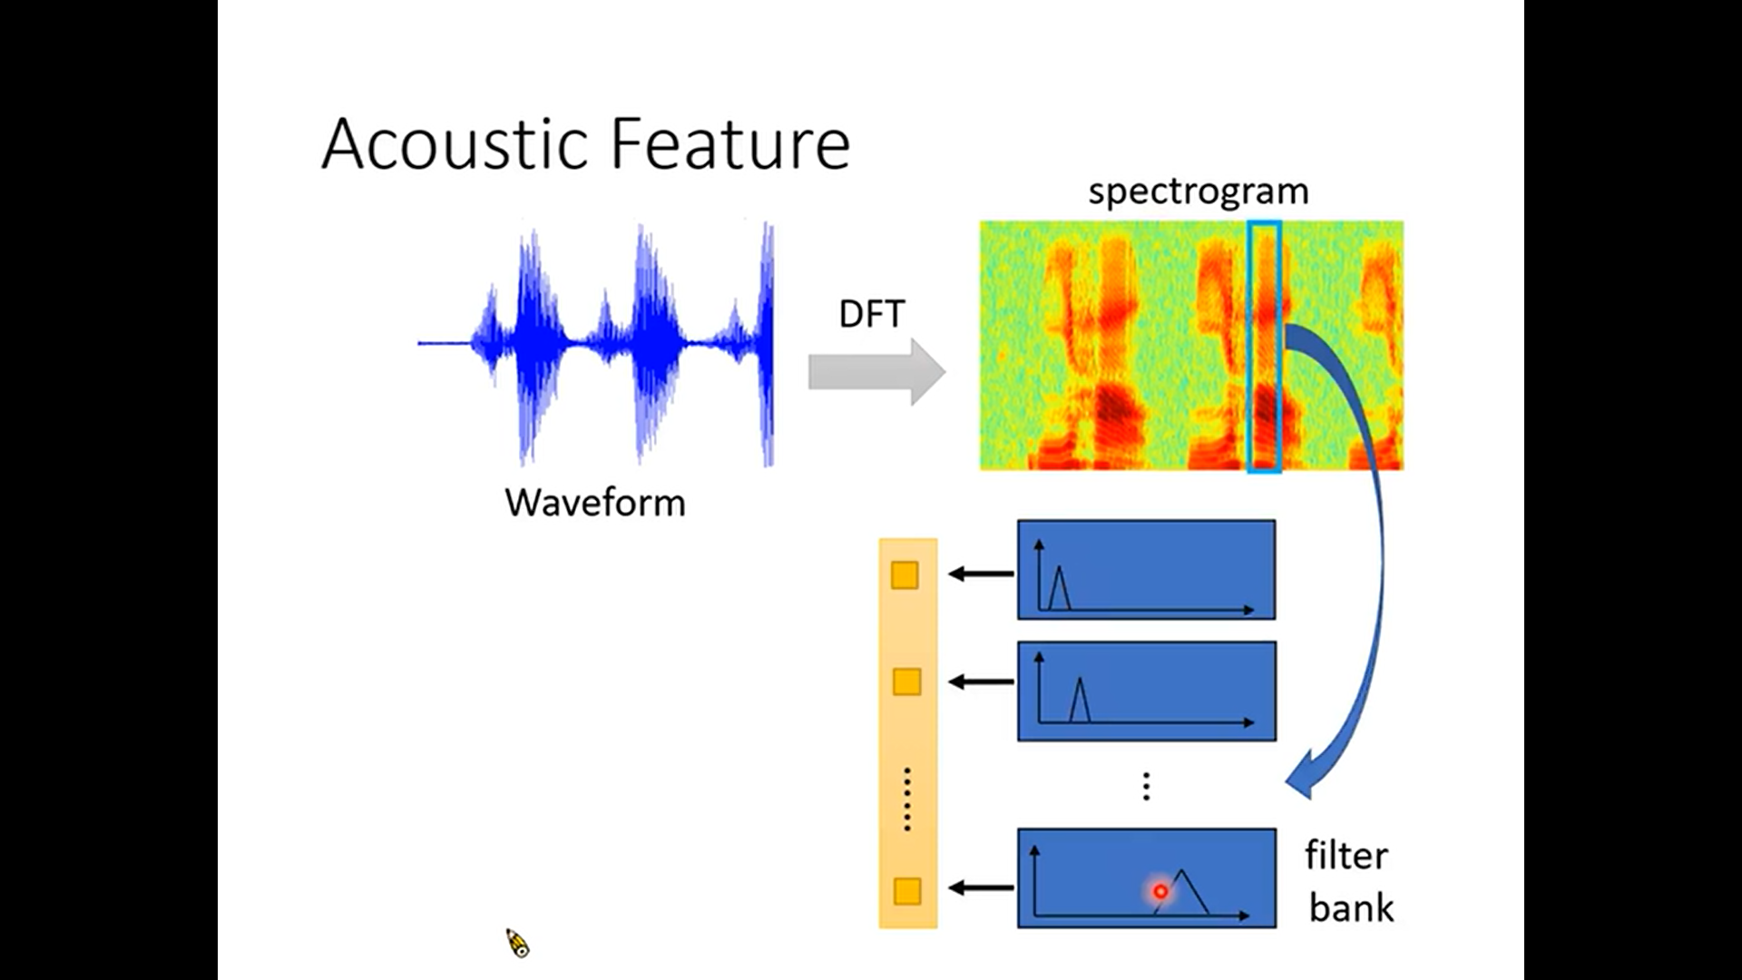

Slide 17
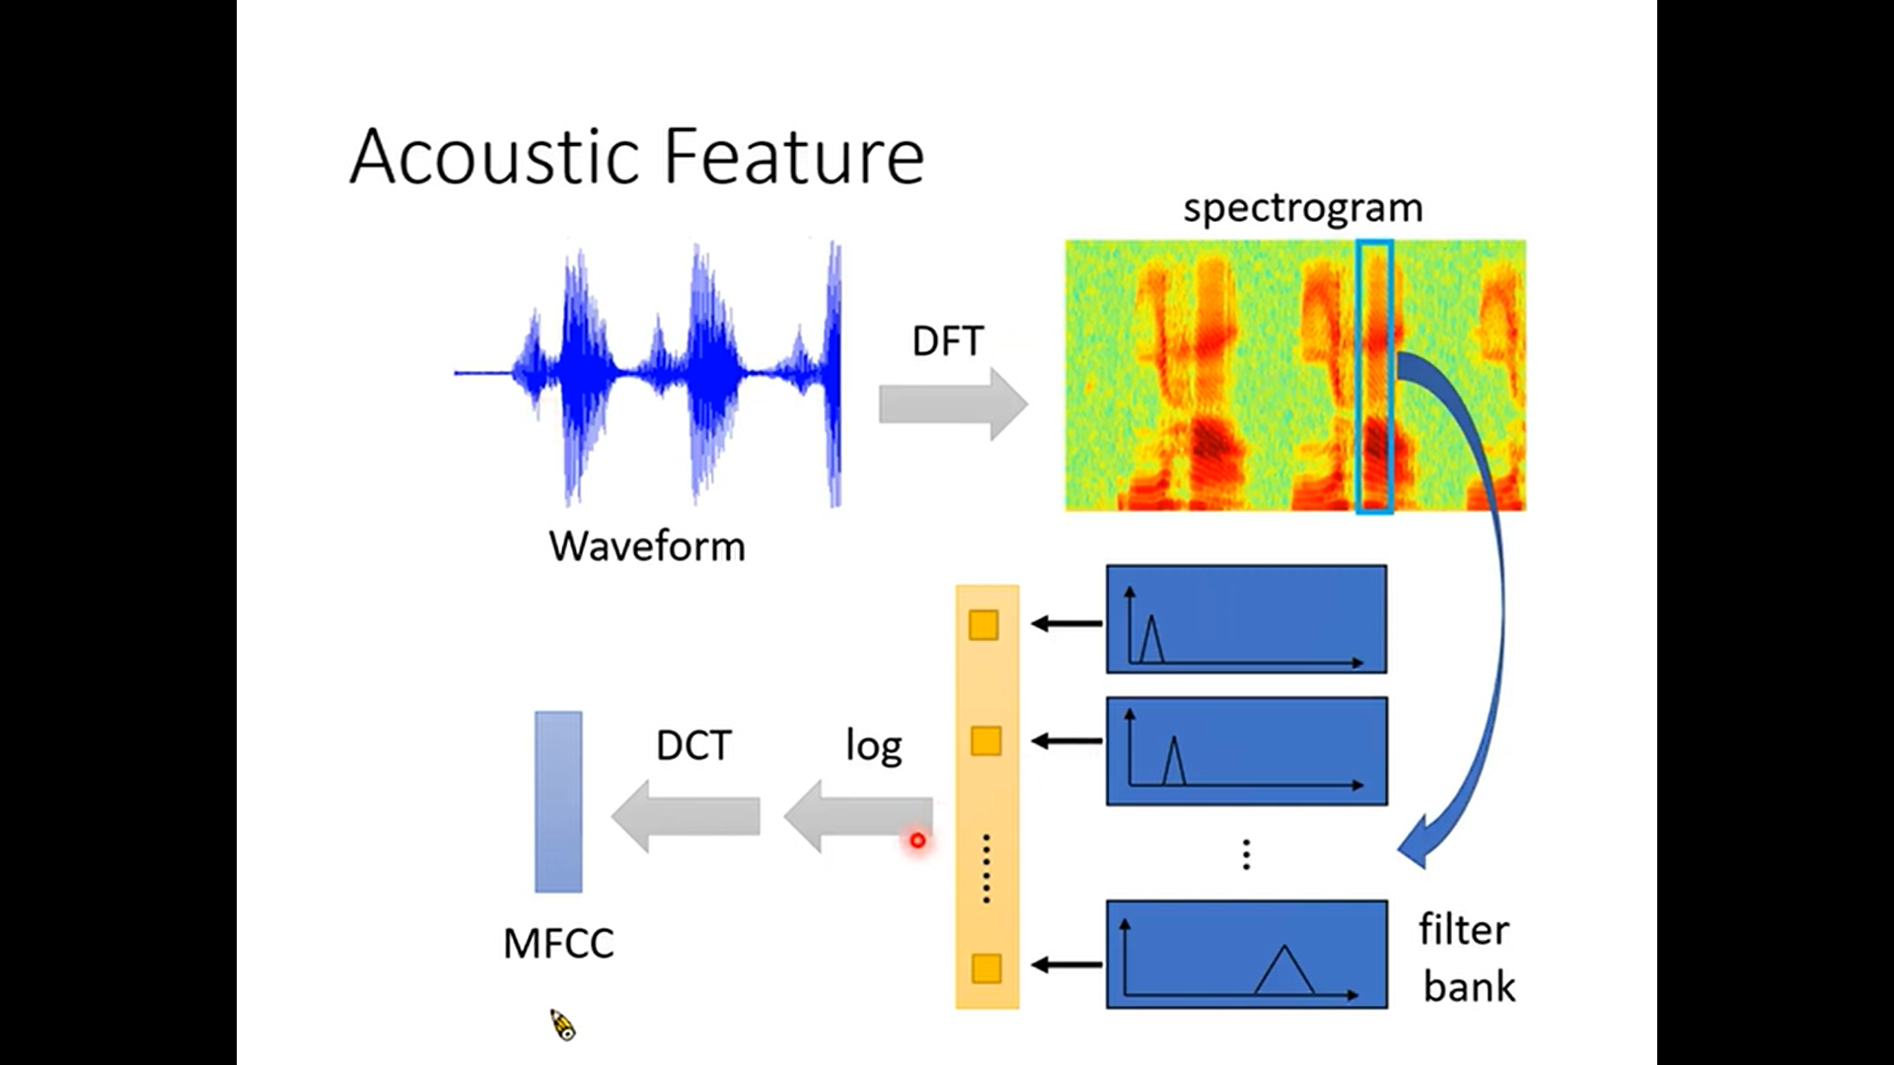

Slide 18
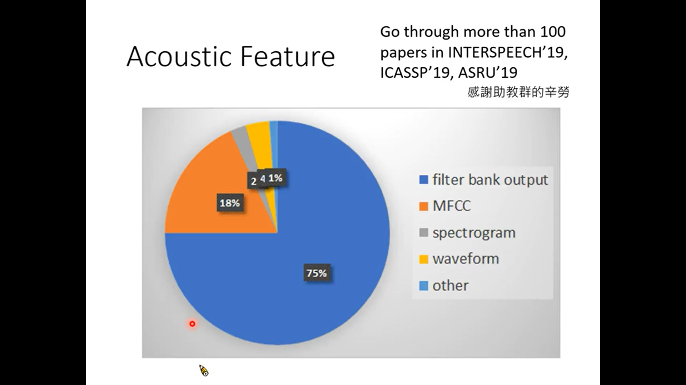

Slide 19
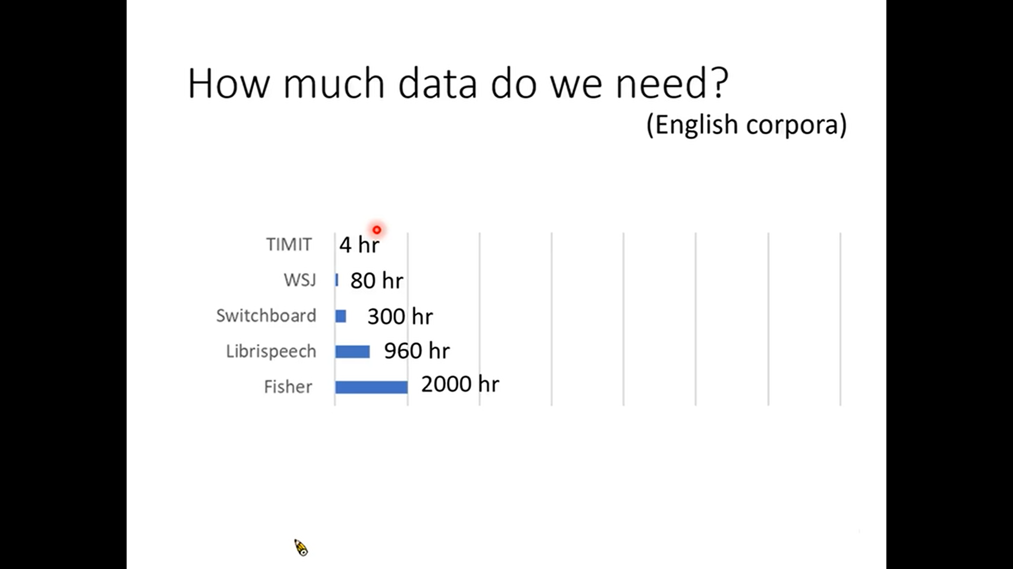

Slide 20
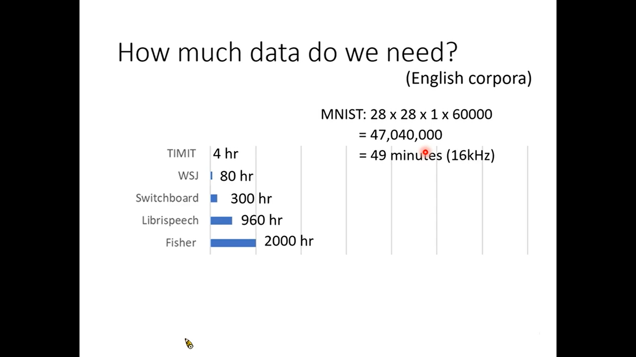

Slide 21
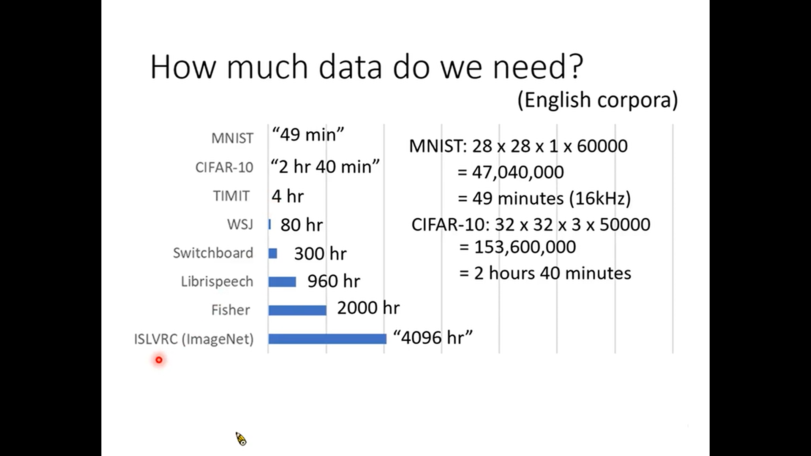

Slide 22
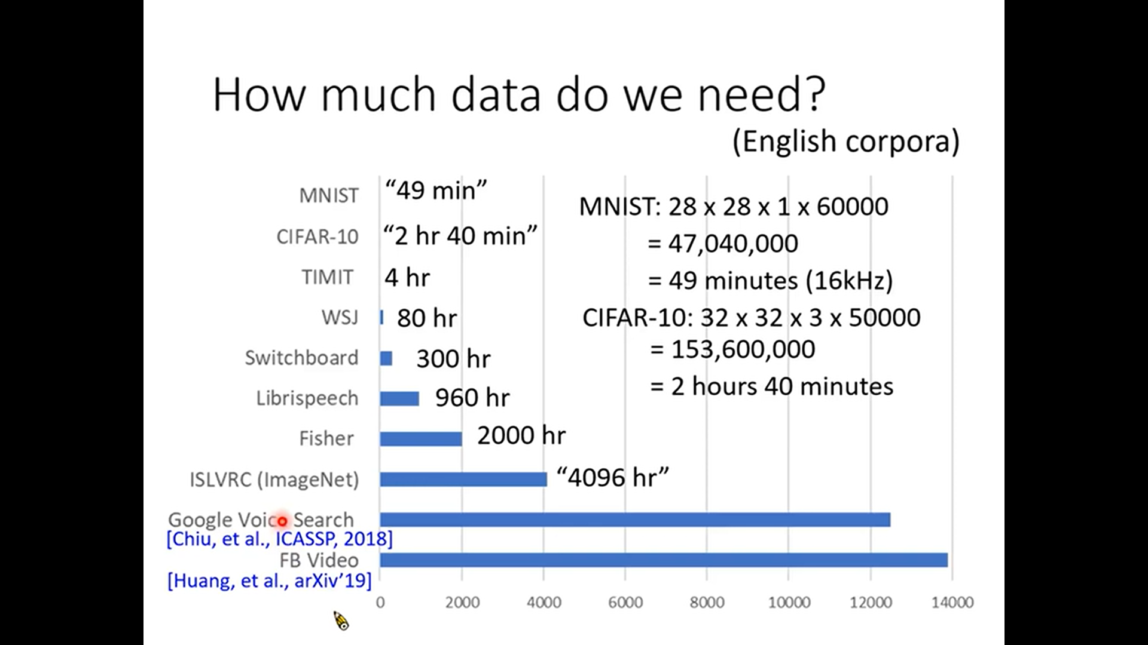

Slide 23
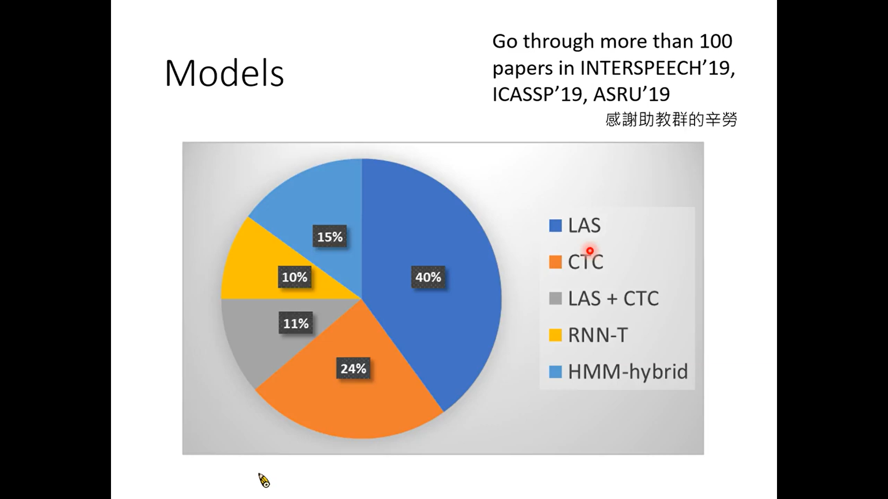

Slide 24
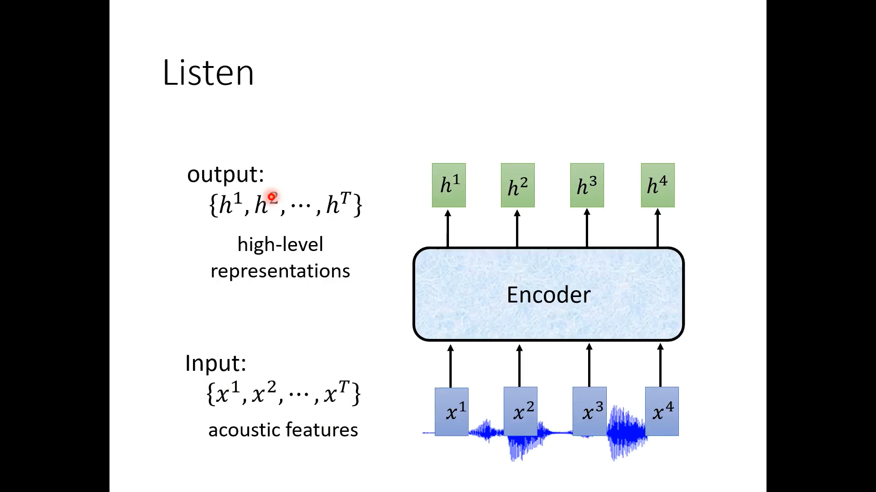

Slide 25
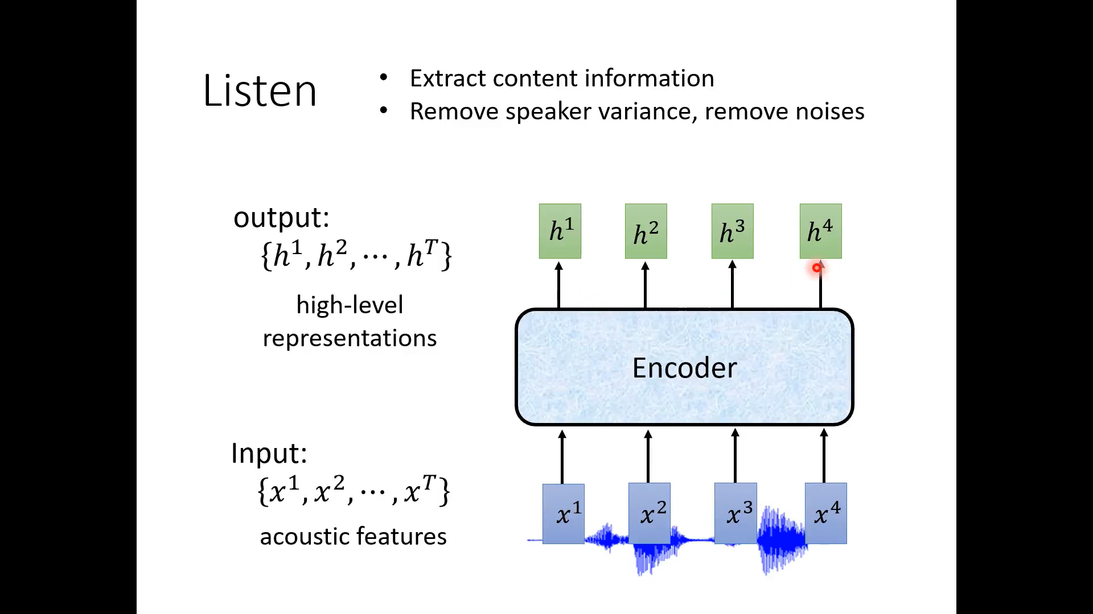

Slide 26
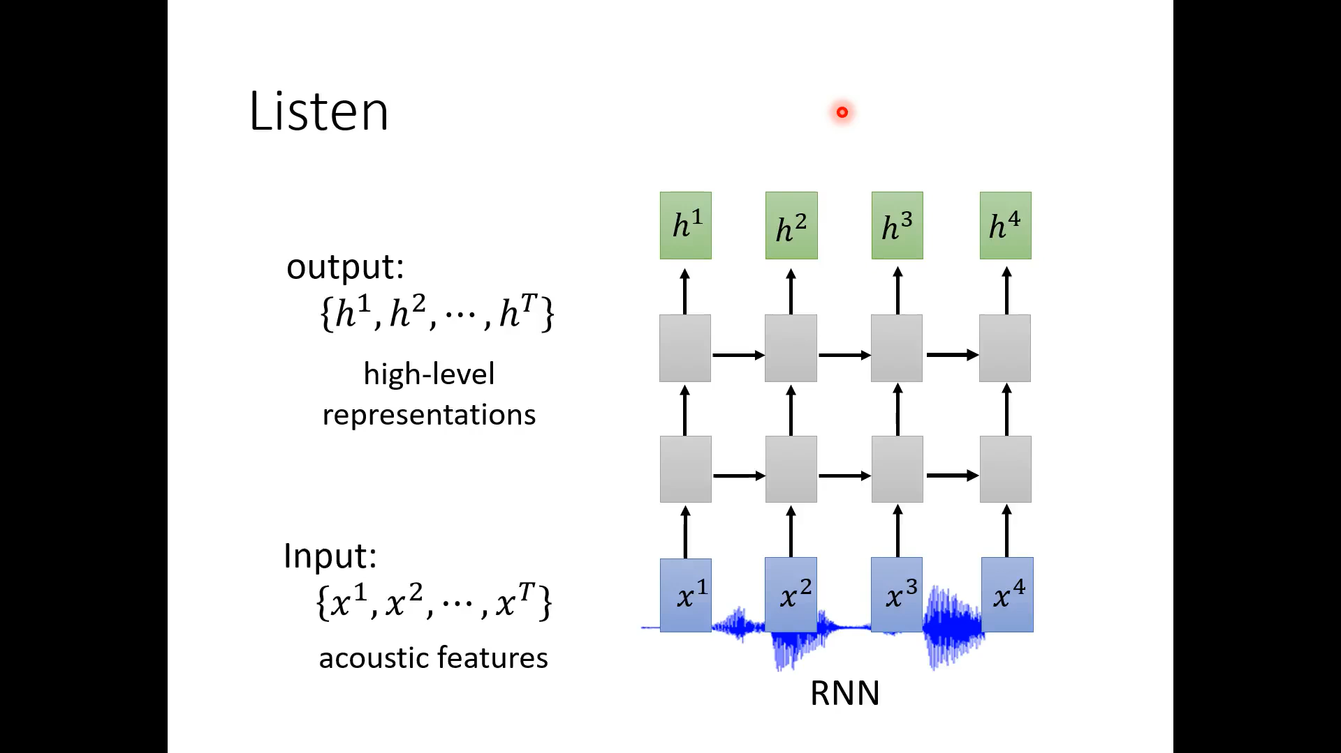

Slide 27
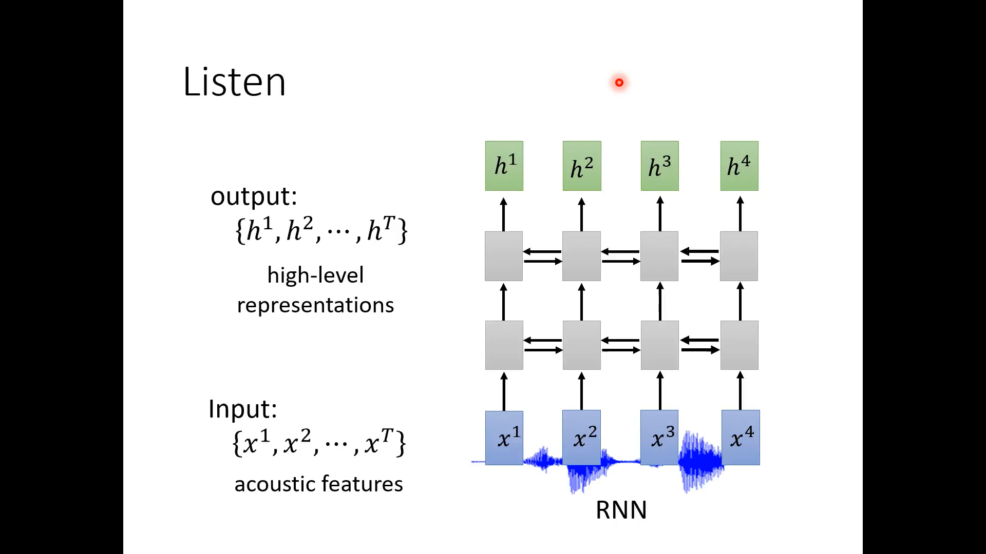

Slide 28
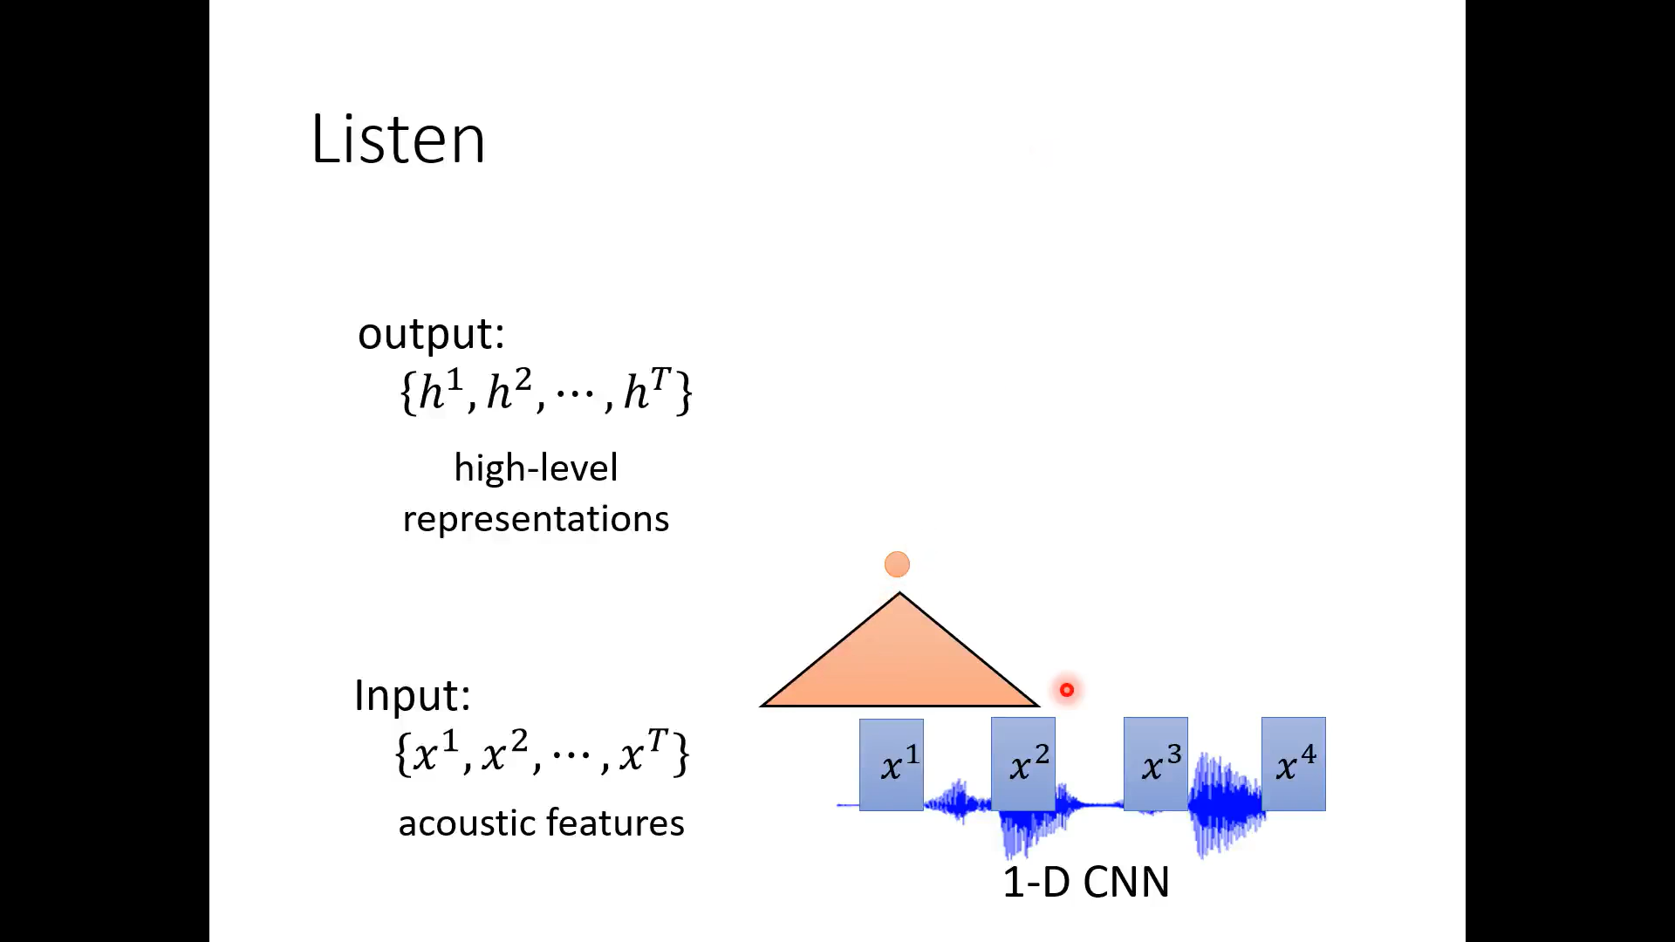

Slide 29
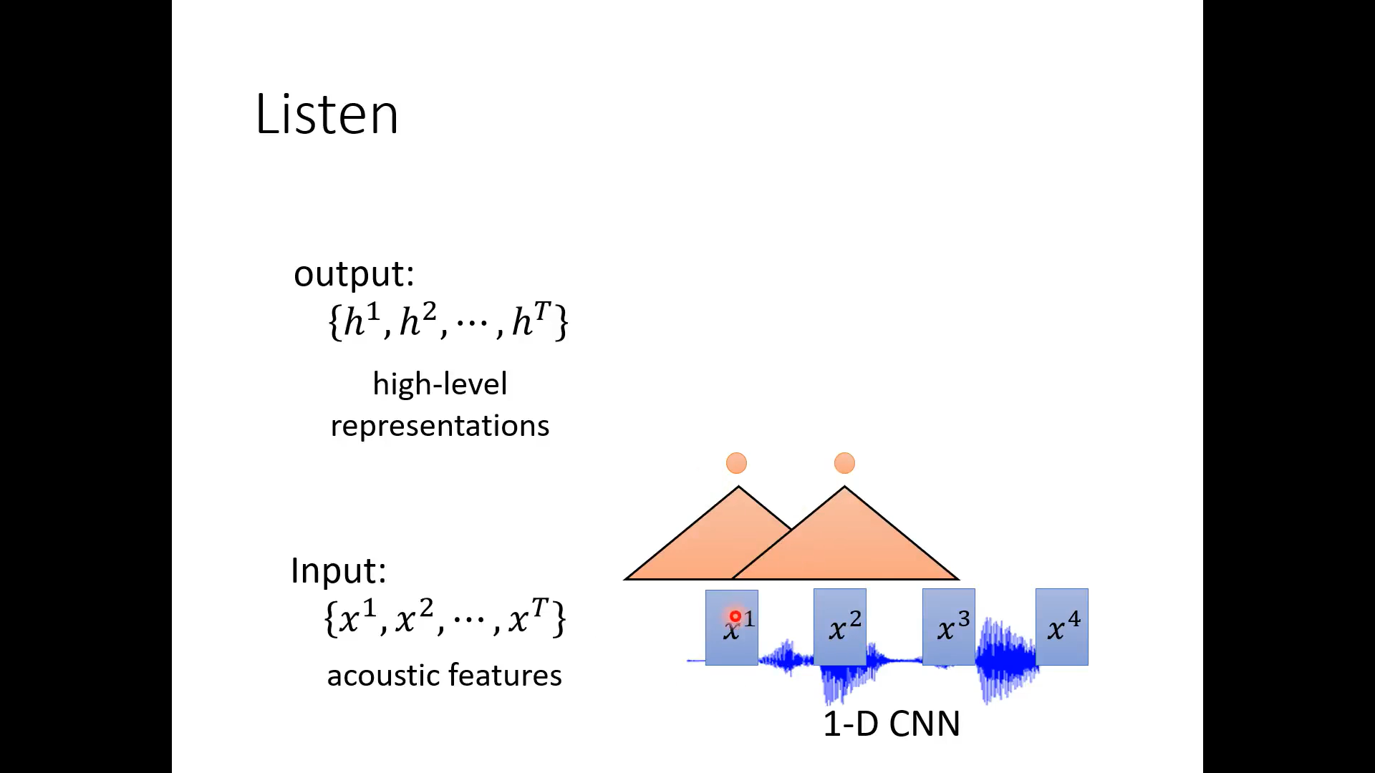

Slide 30
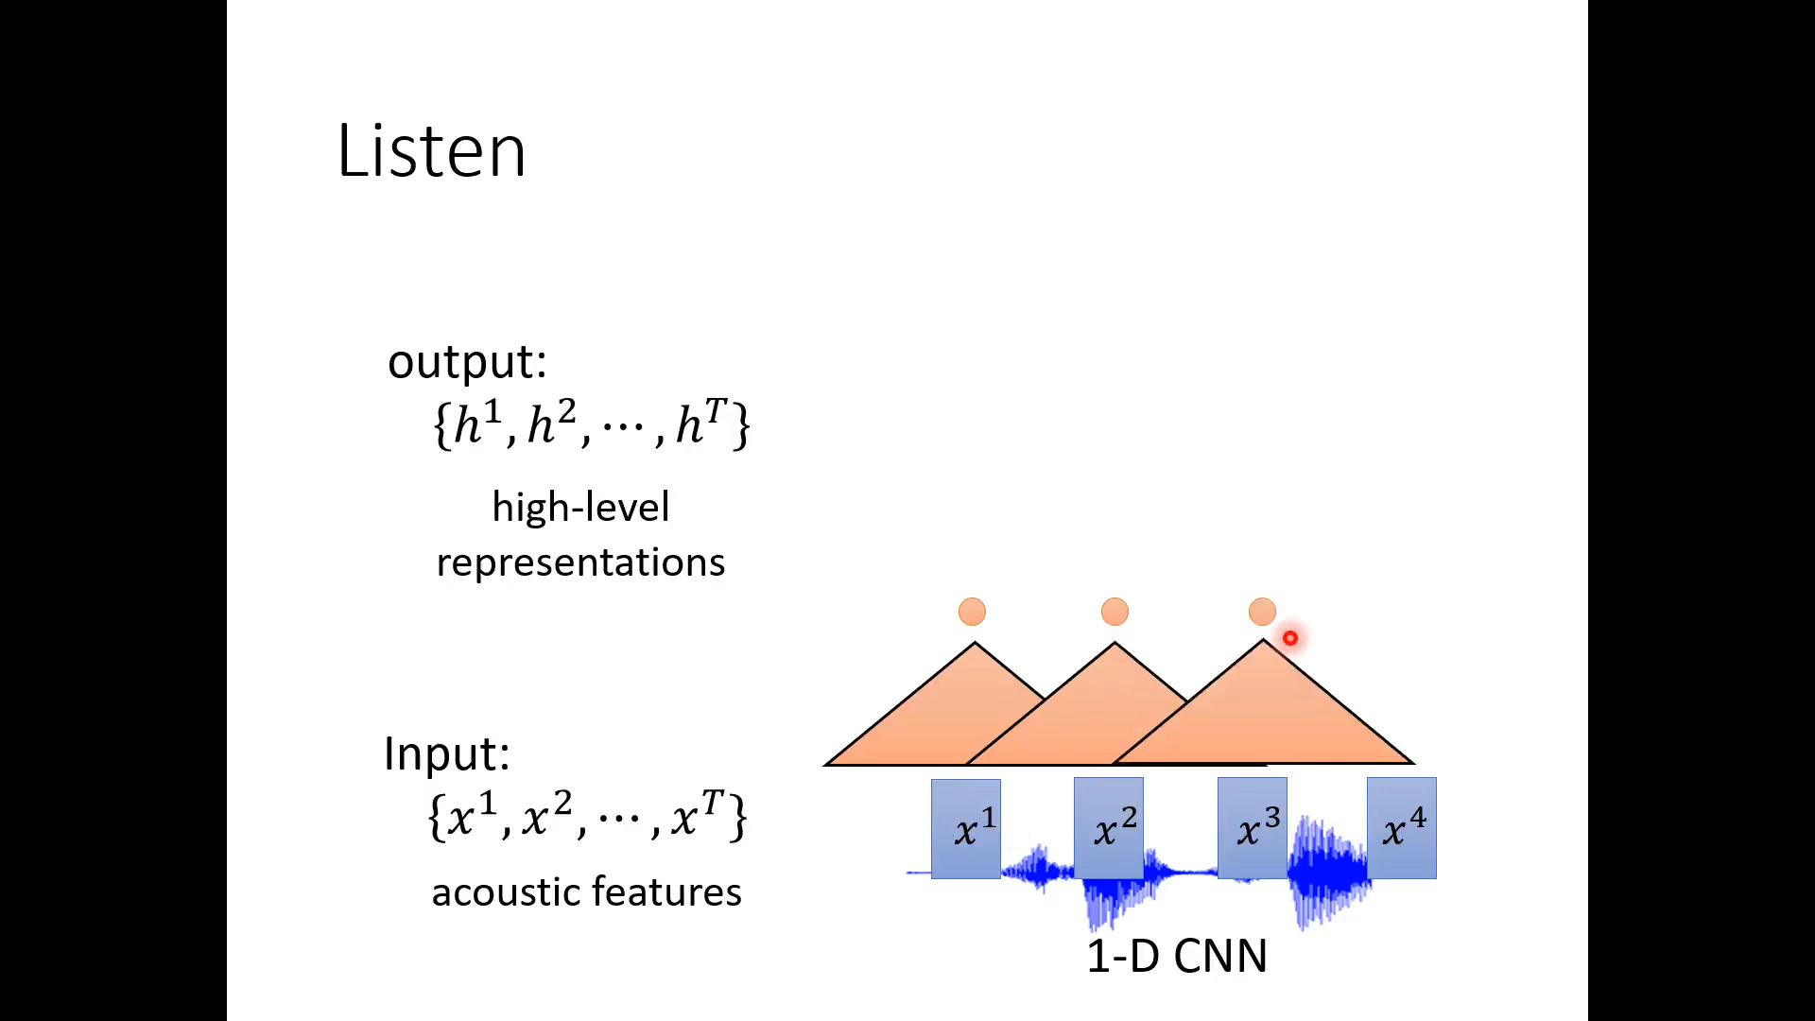

Slide 31
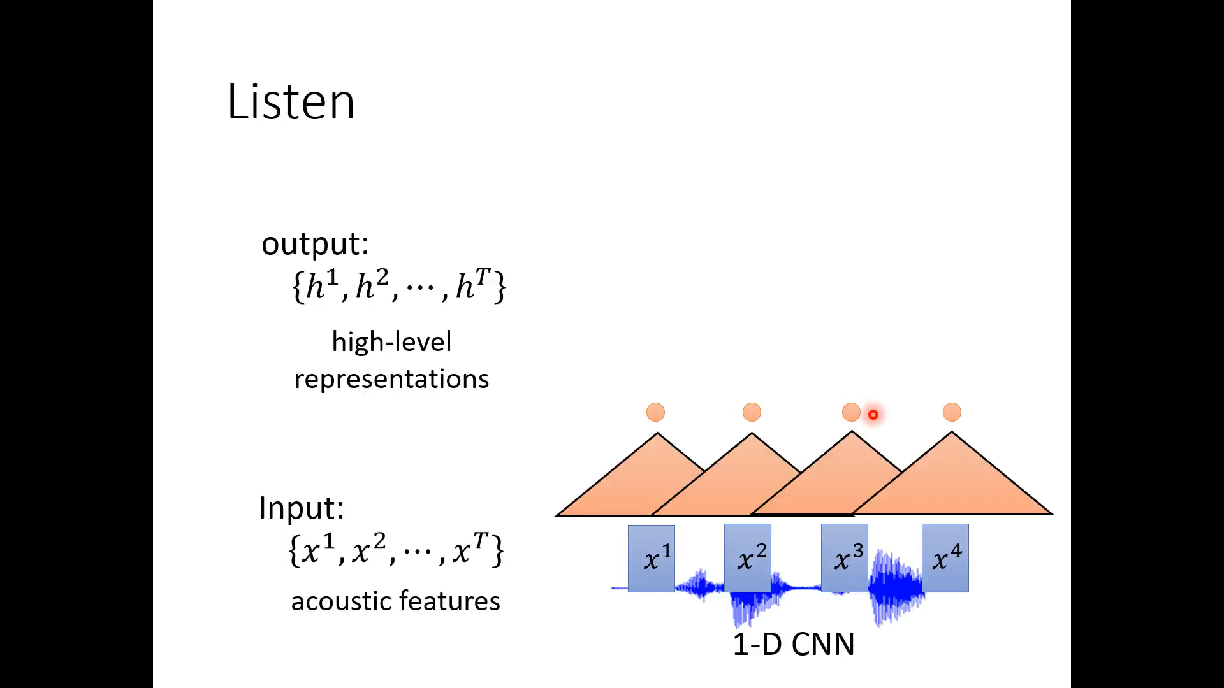

Slide 32
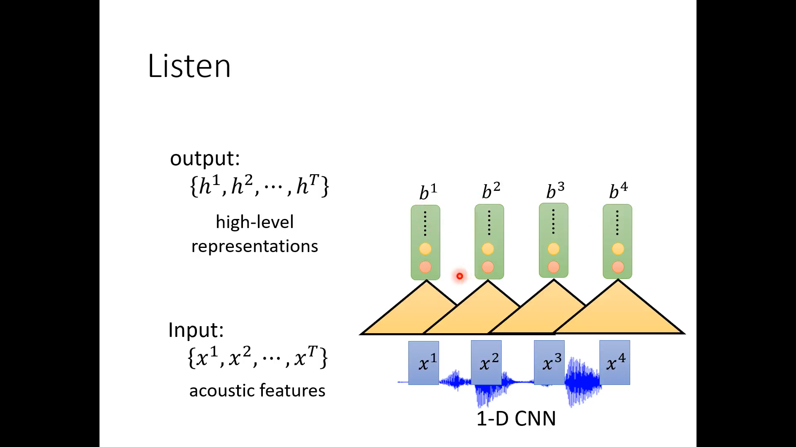

Slide 33
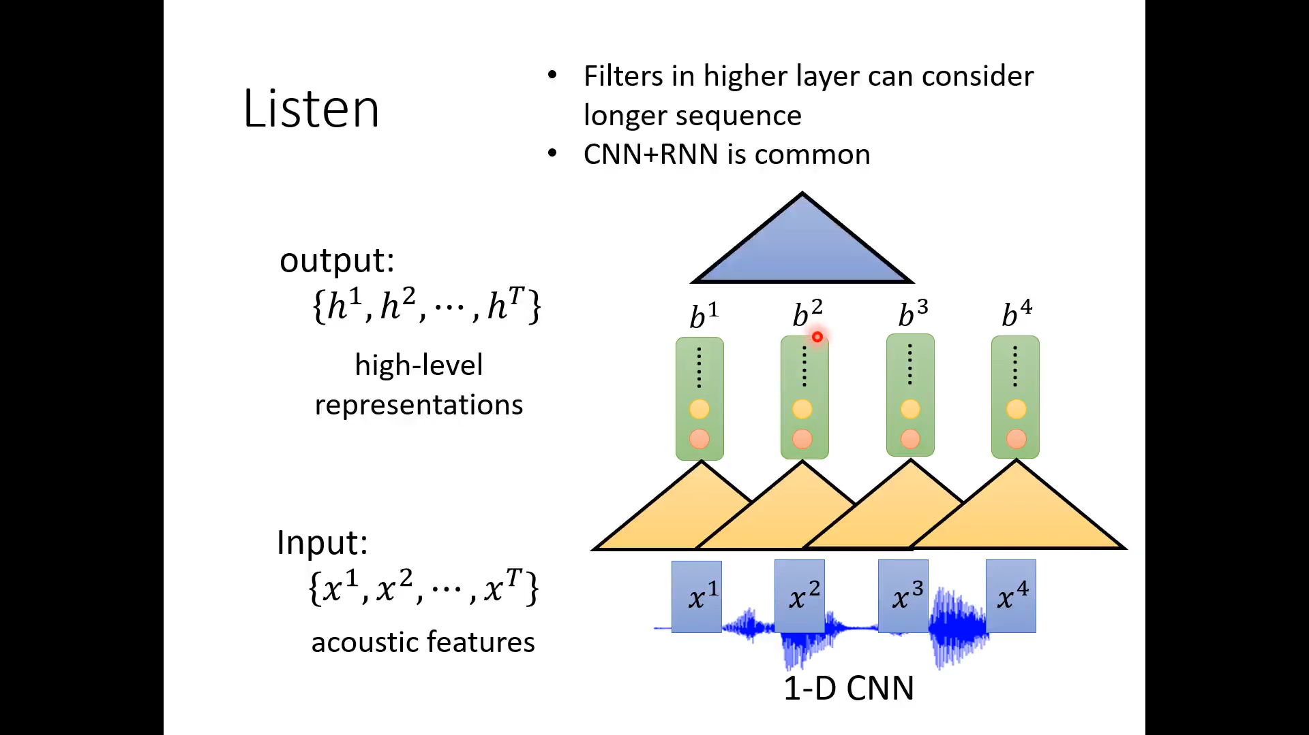

Slide 34
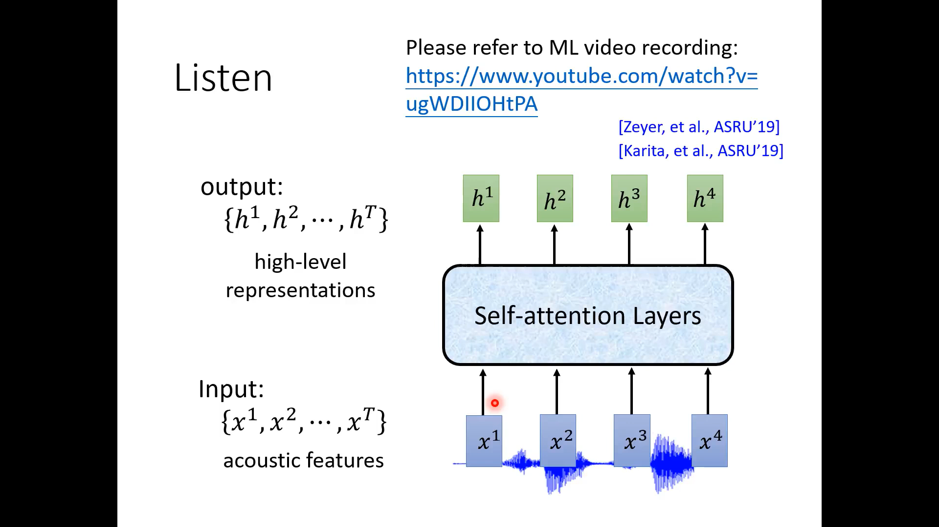

Slide 35
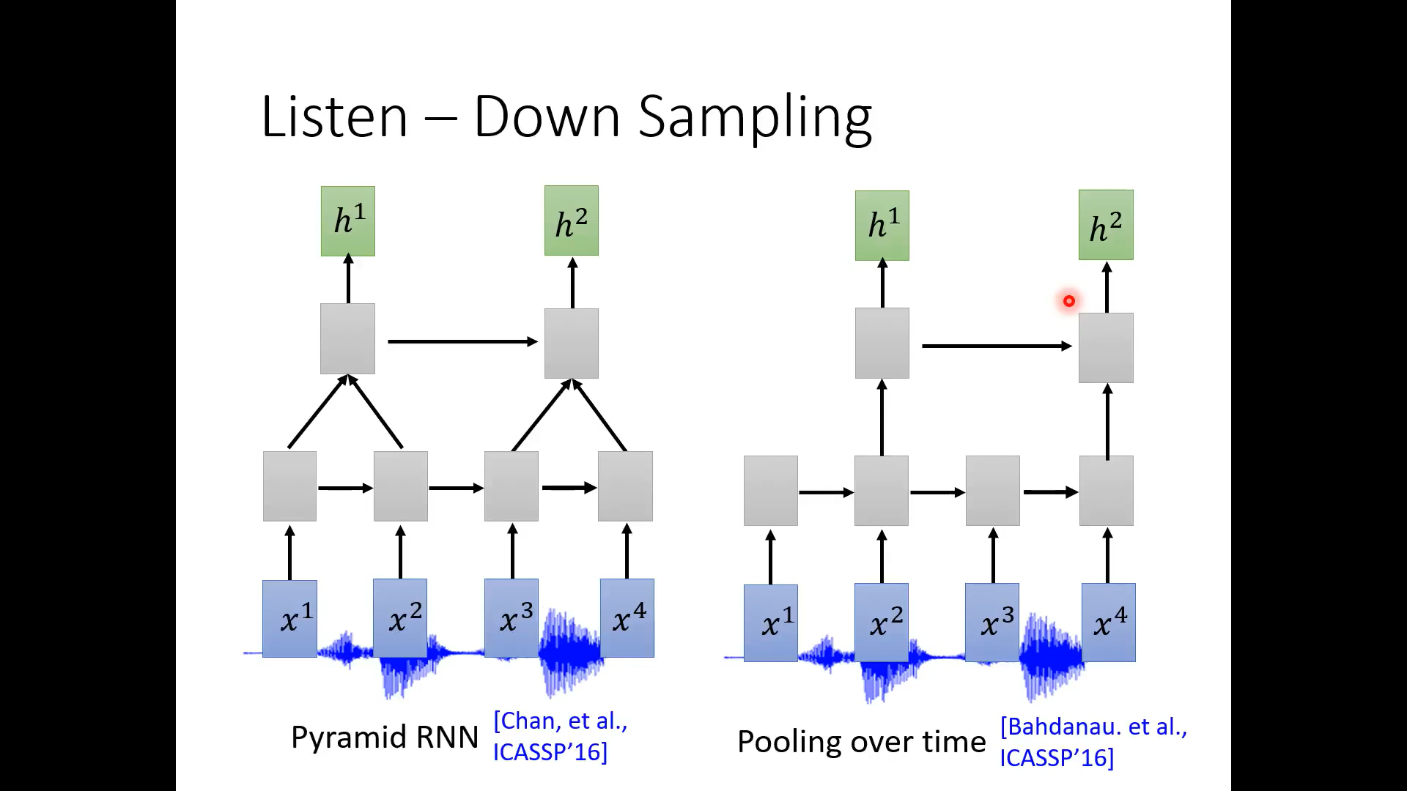

Slide 36
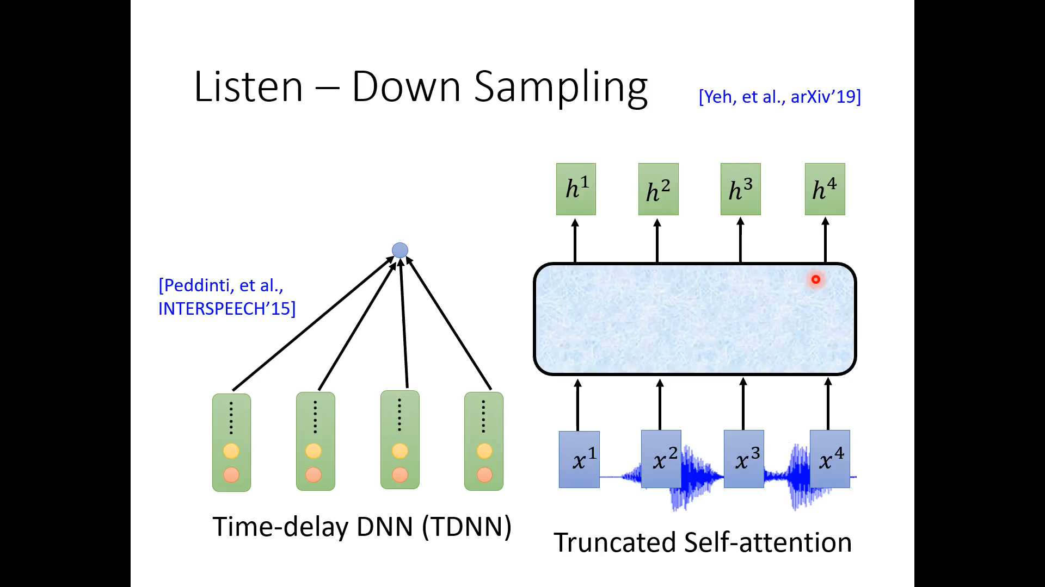

Slide 37
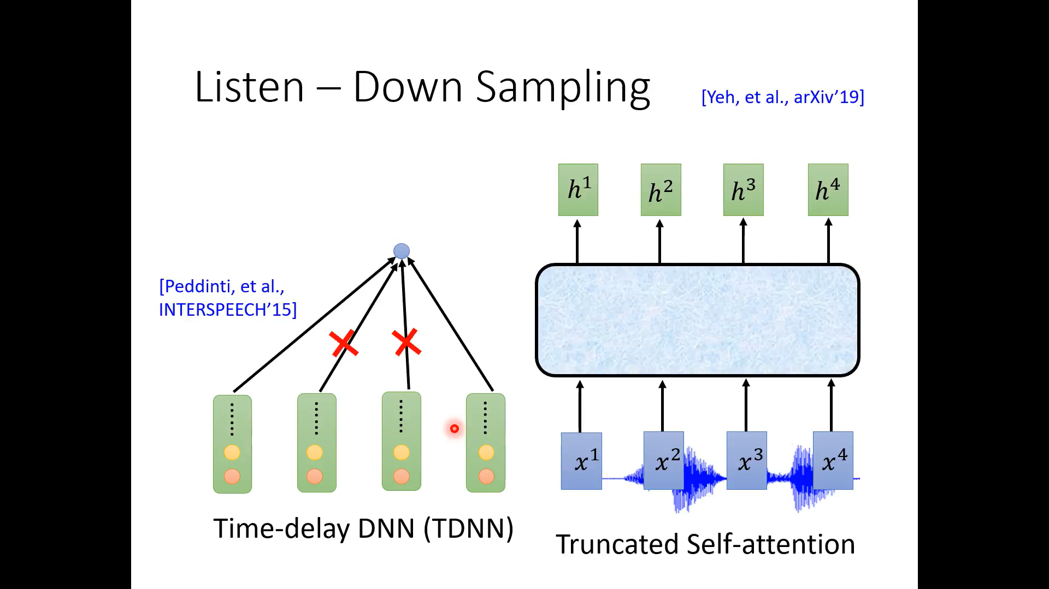

Slide 38
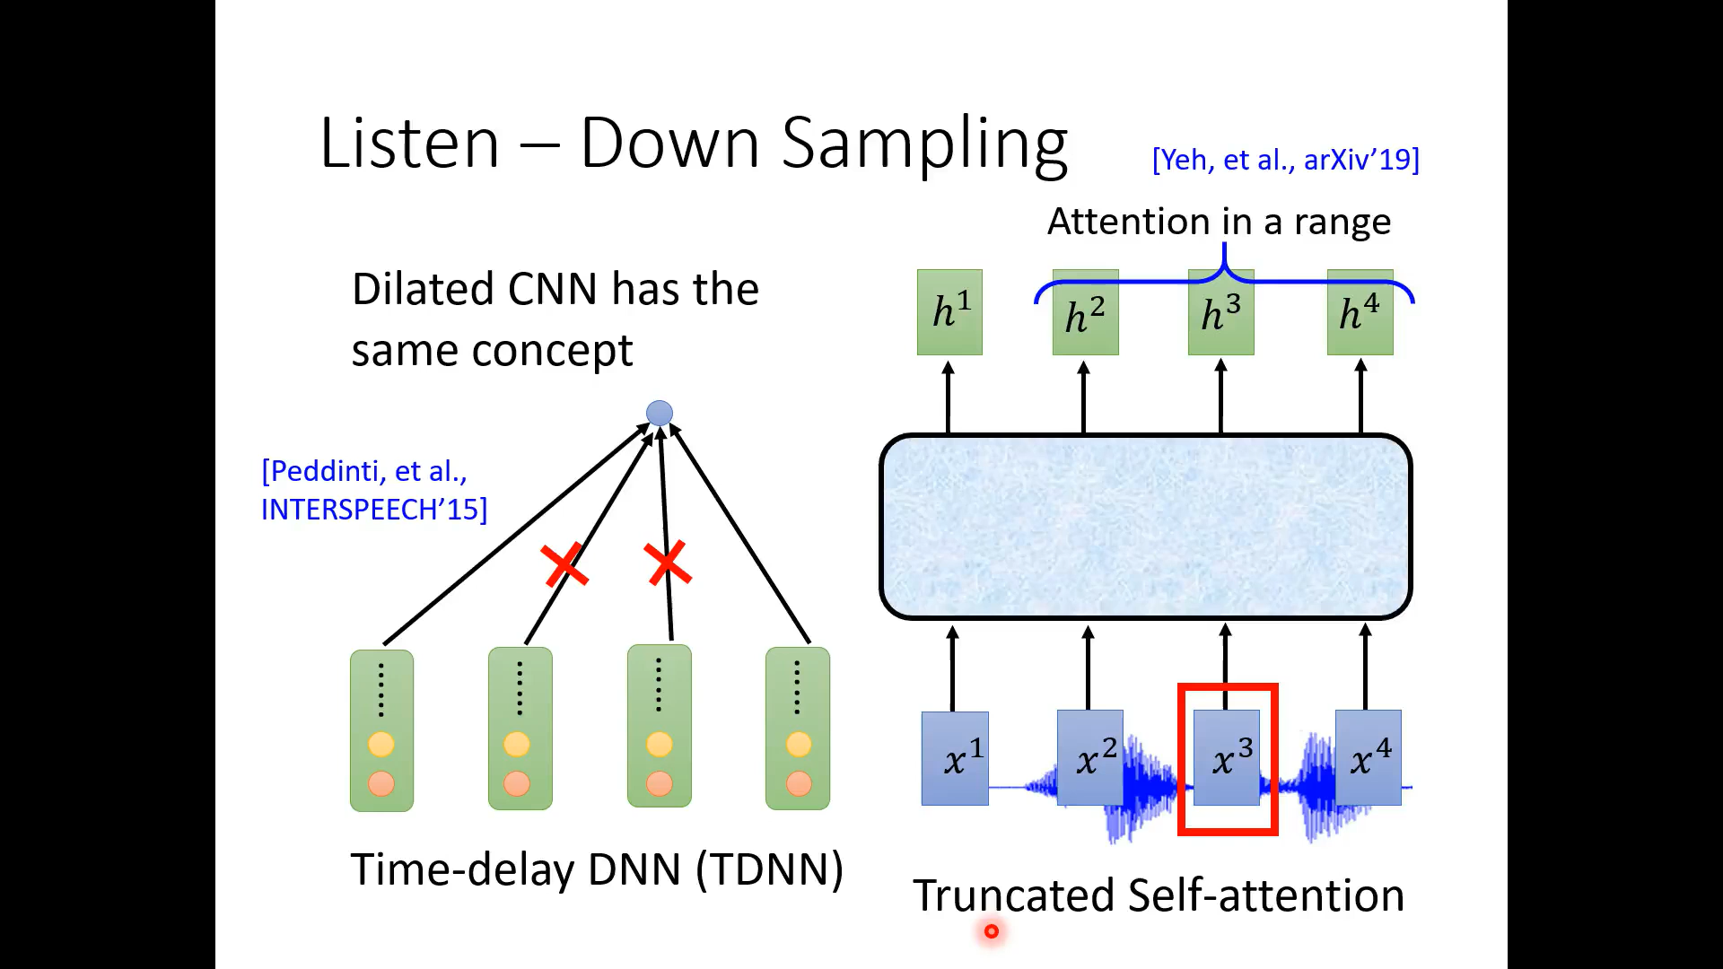

Slide 39
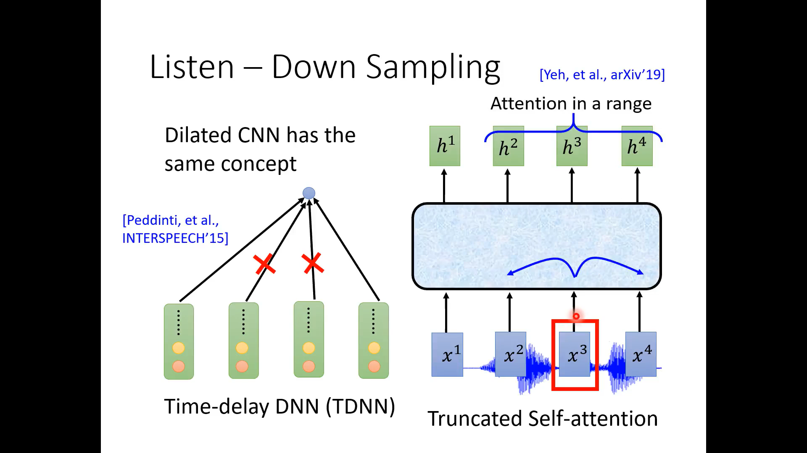

Slide 40
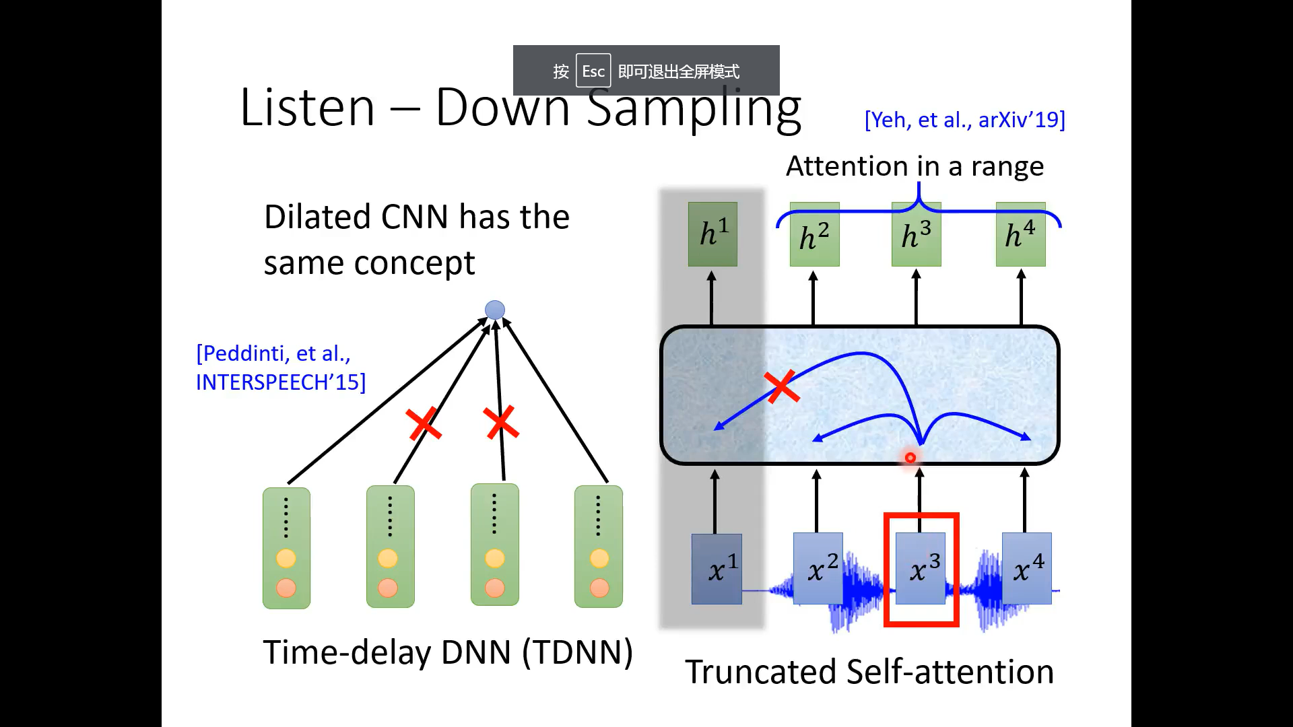

Slide 41
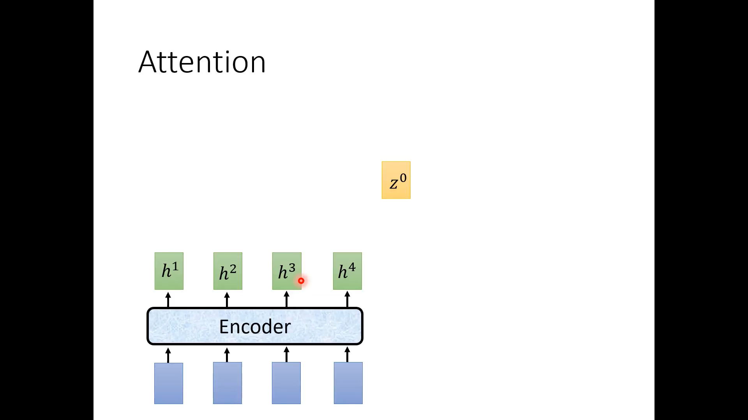

Slide 42
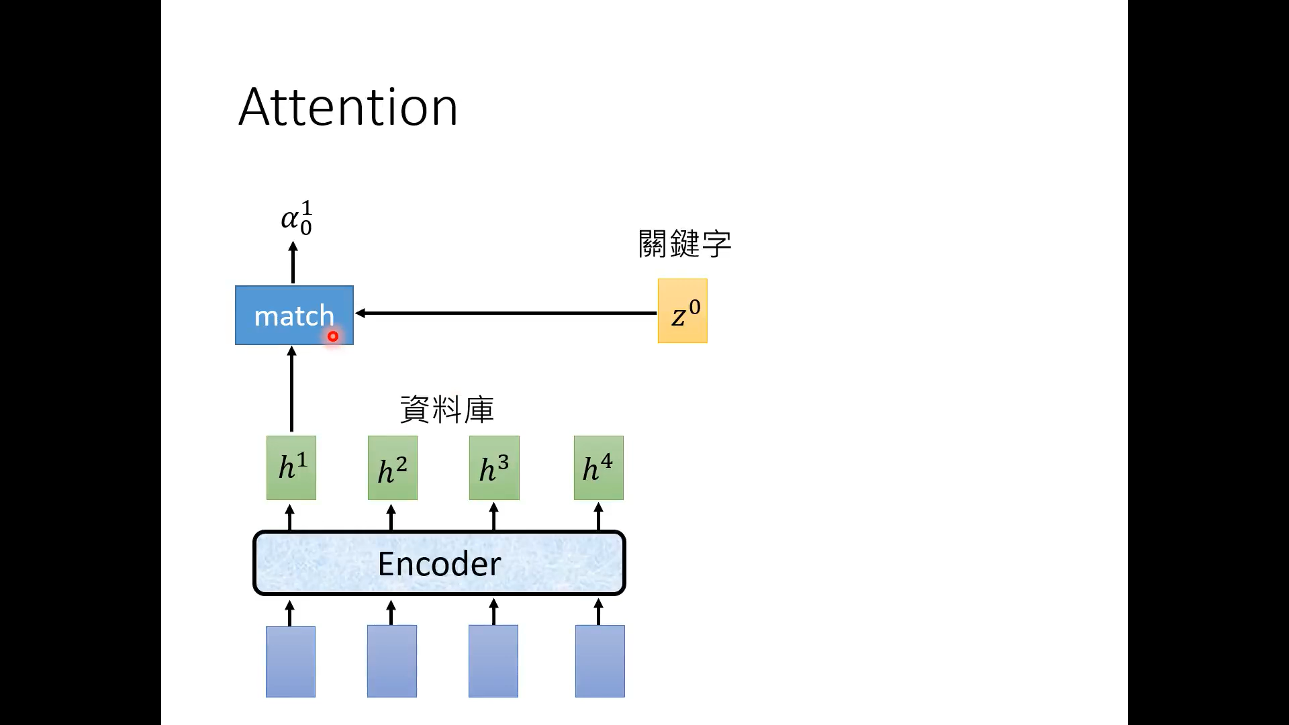

Slide 43
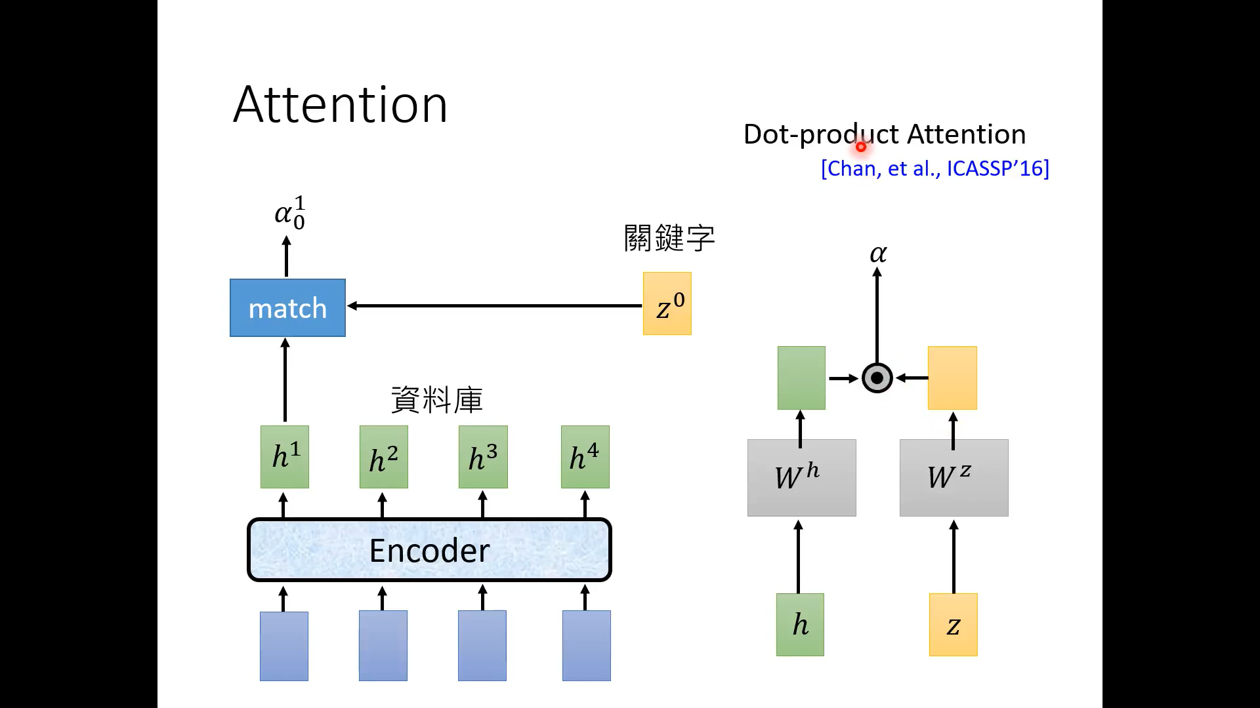

Slide 44
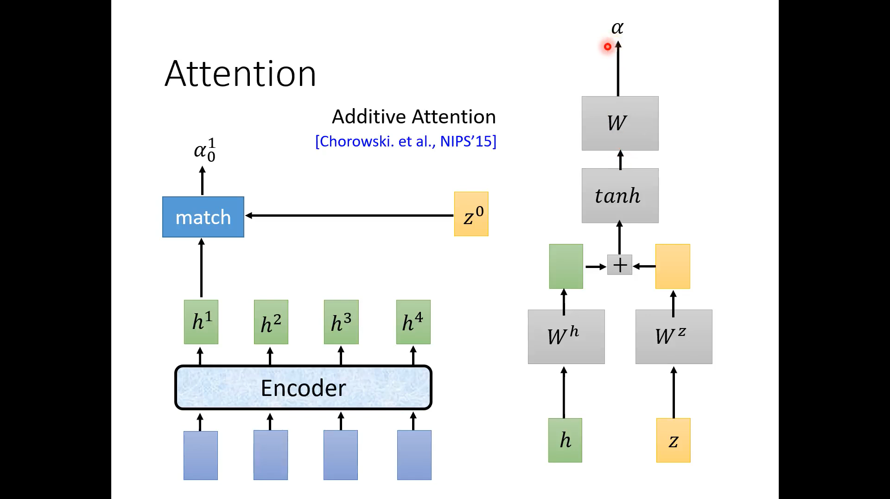

Slide 45
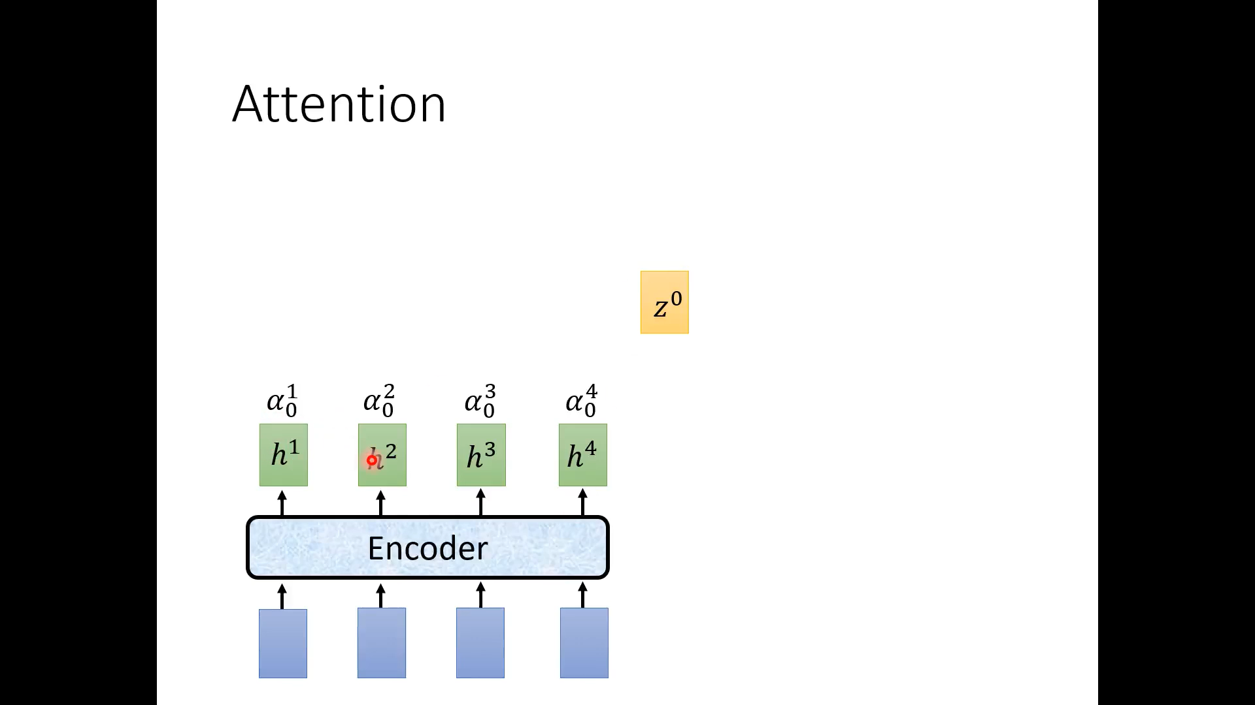

Slide 46
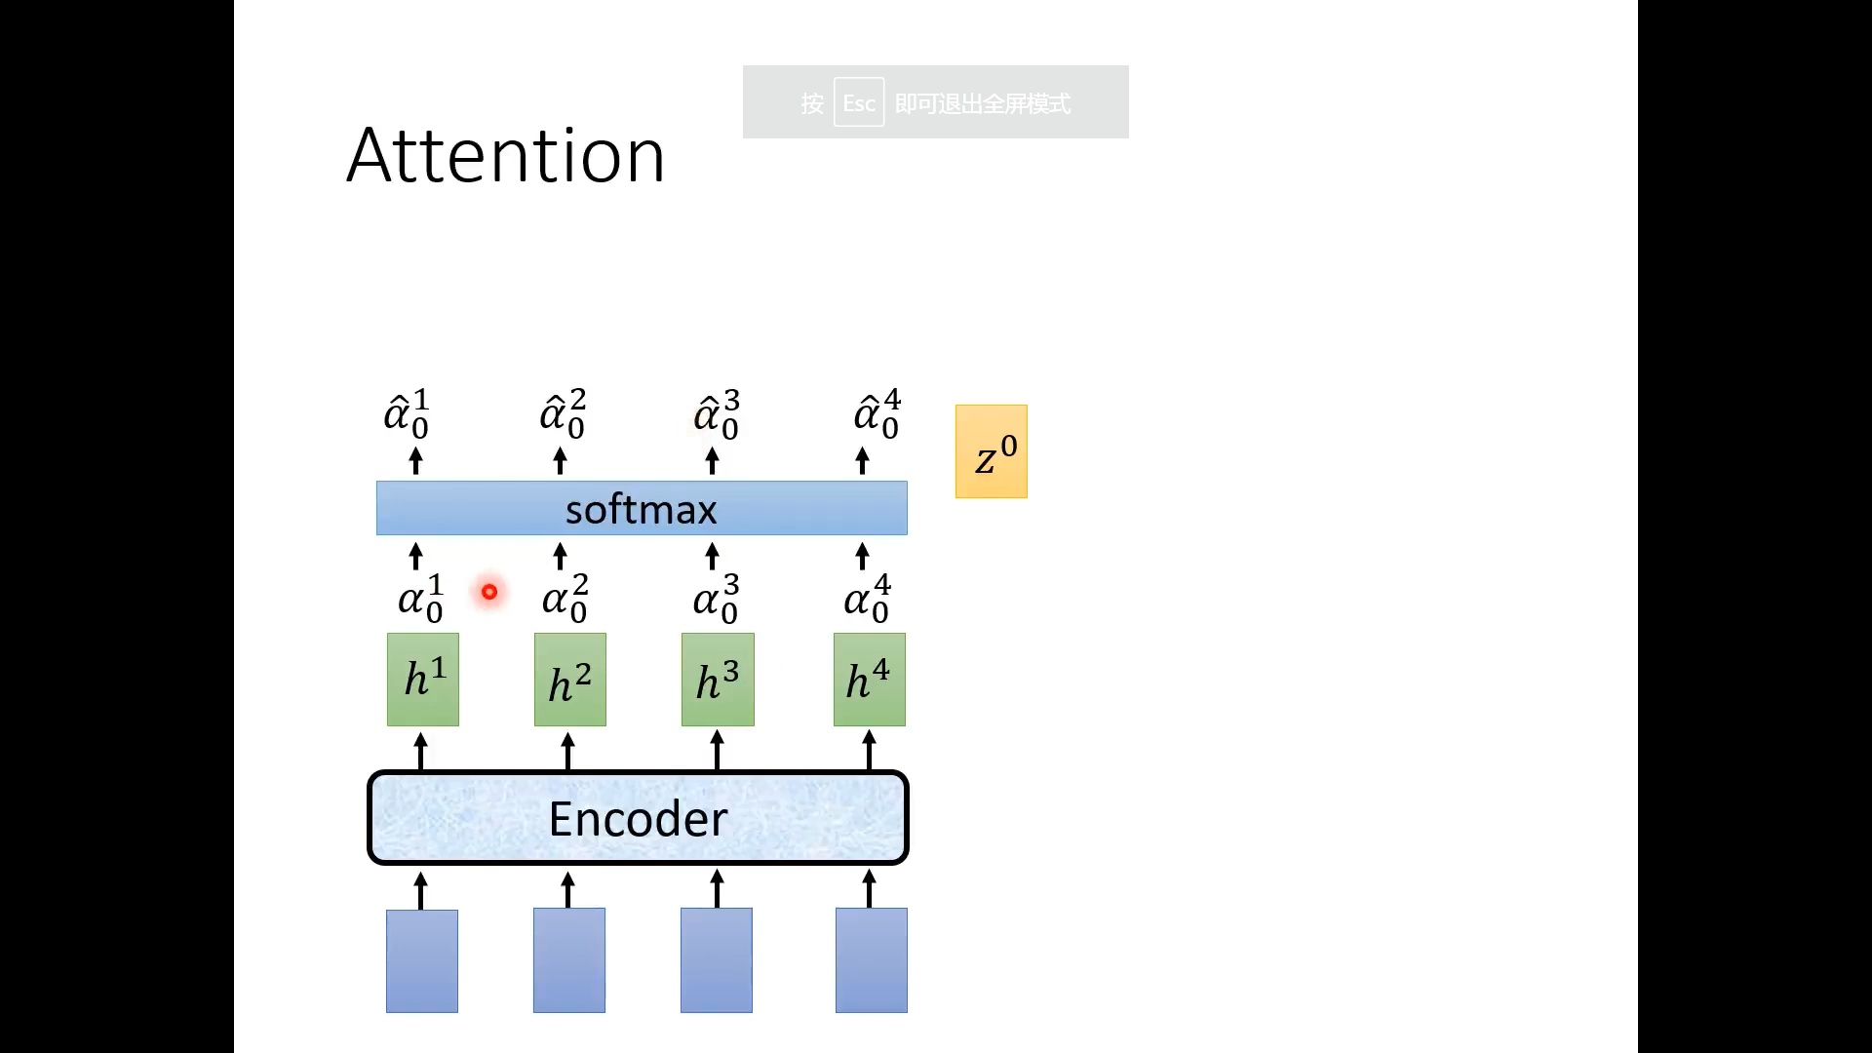

Slide 47
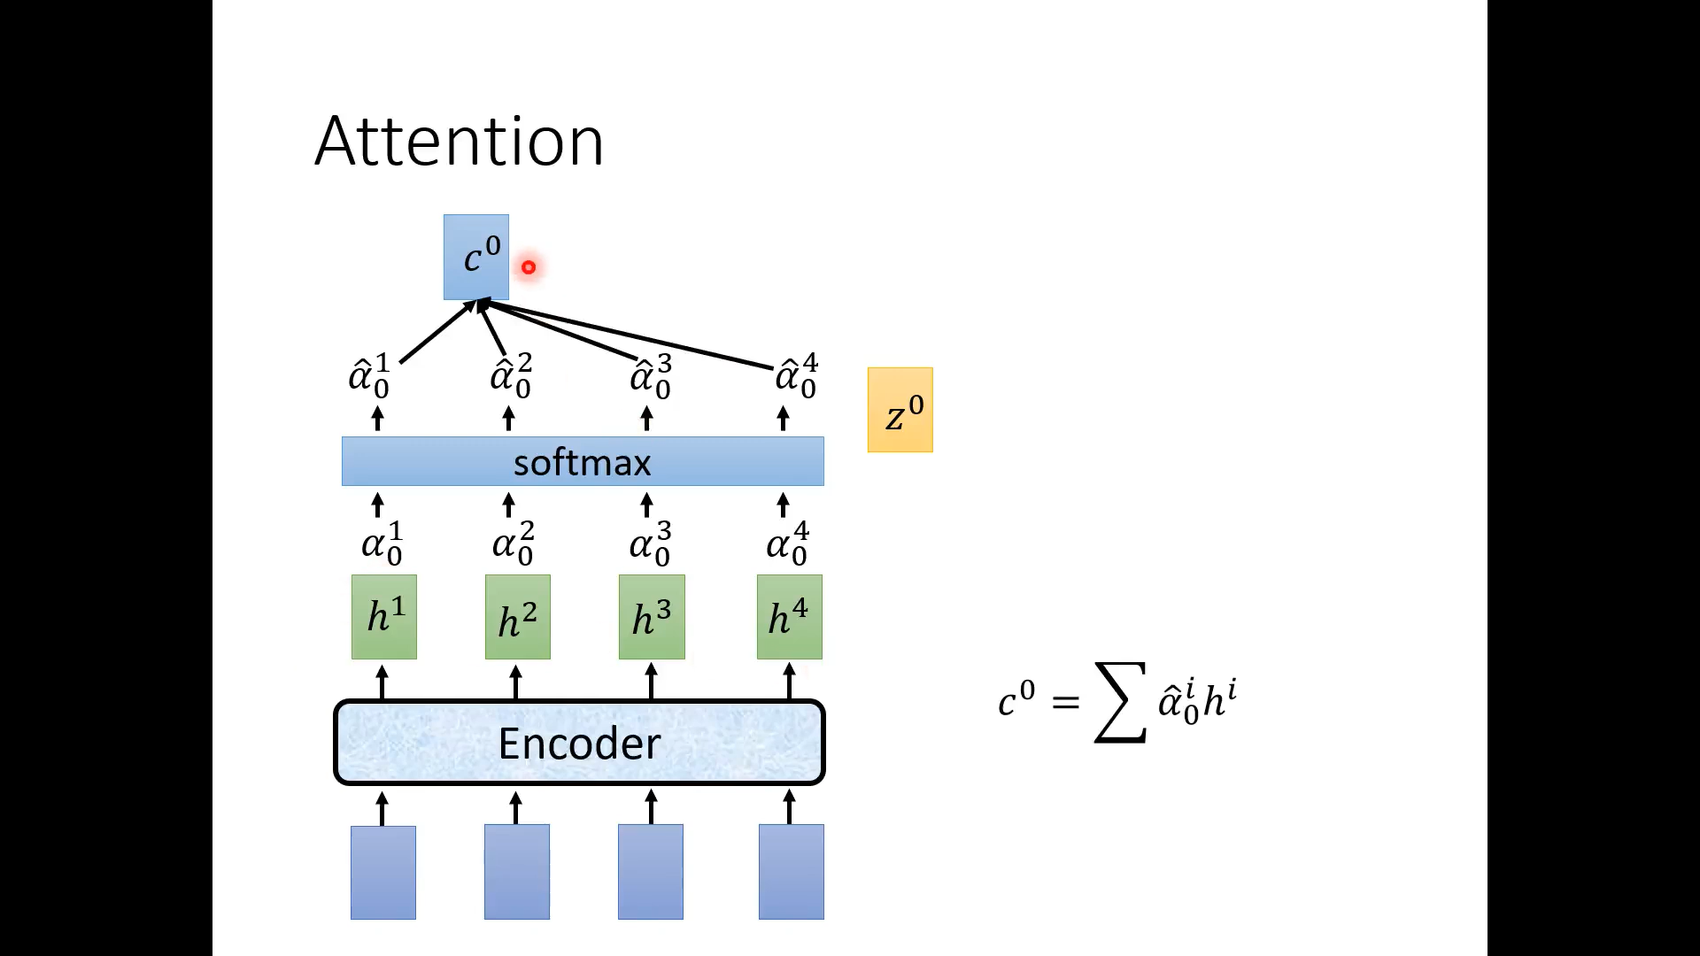

Slide 48
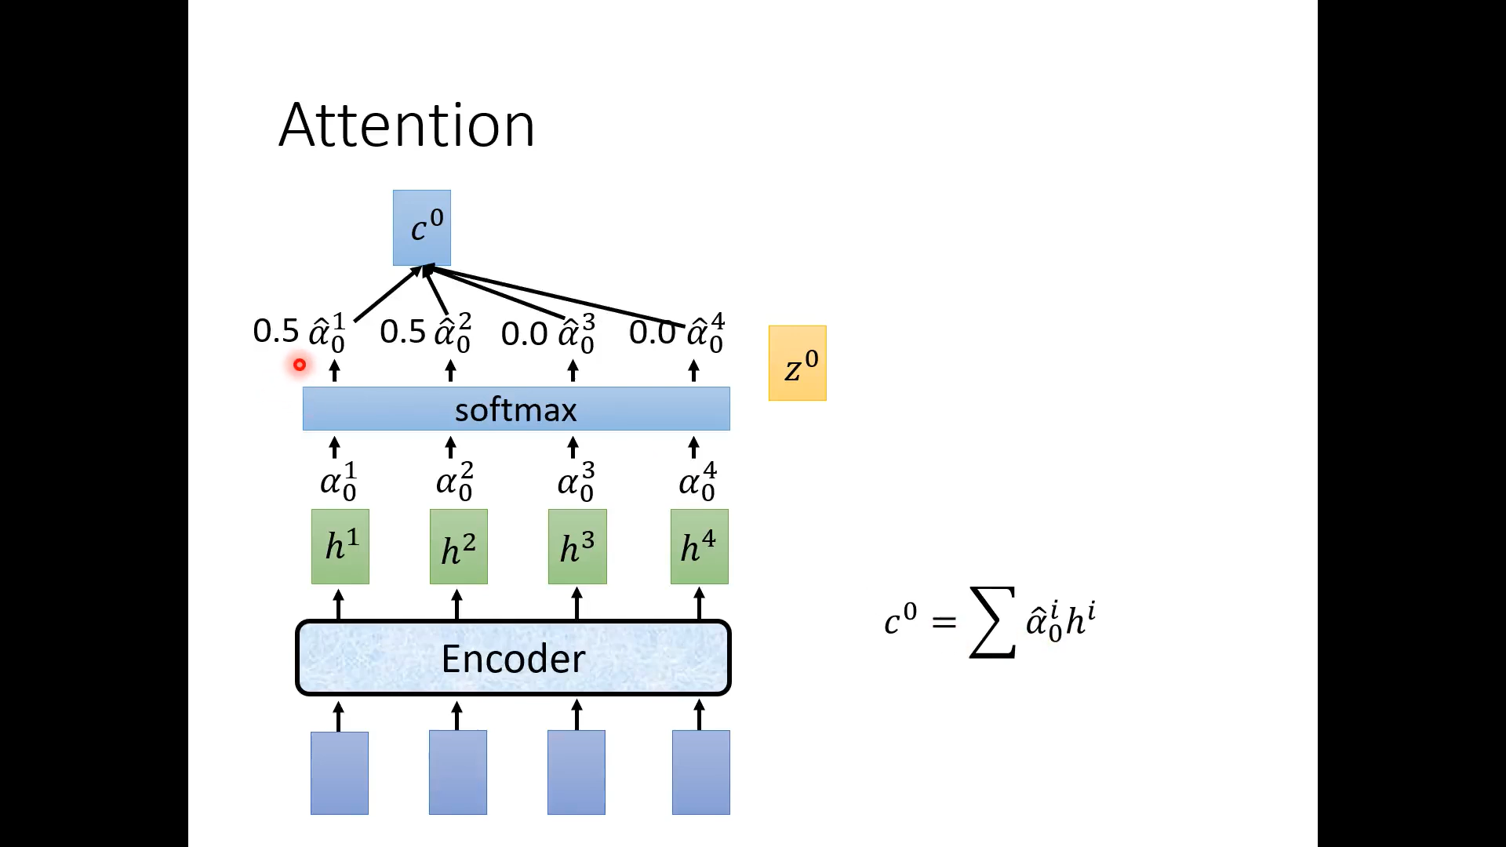

Slide 49
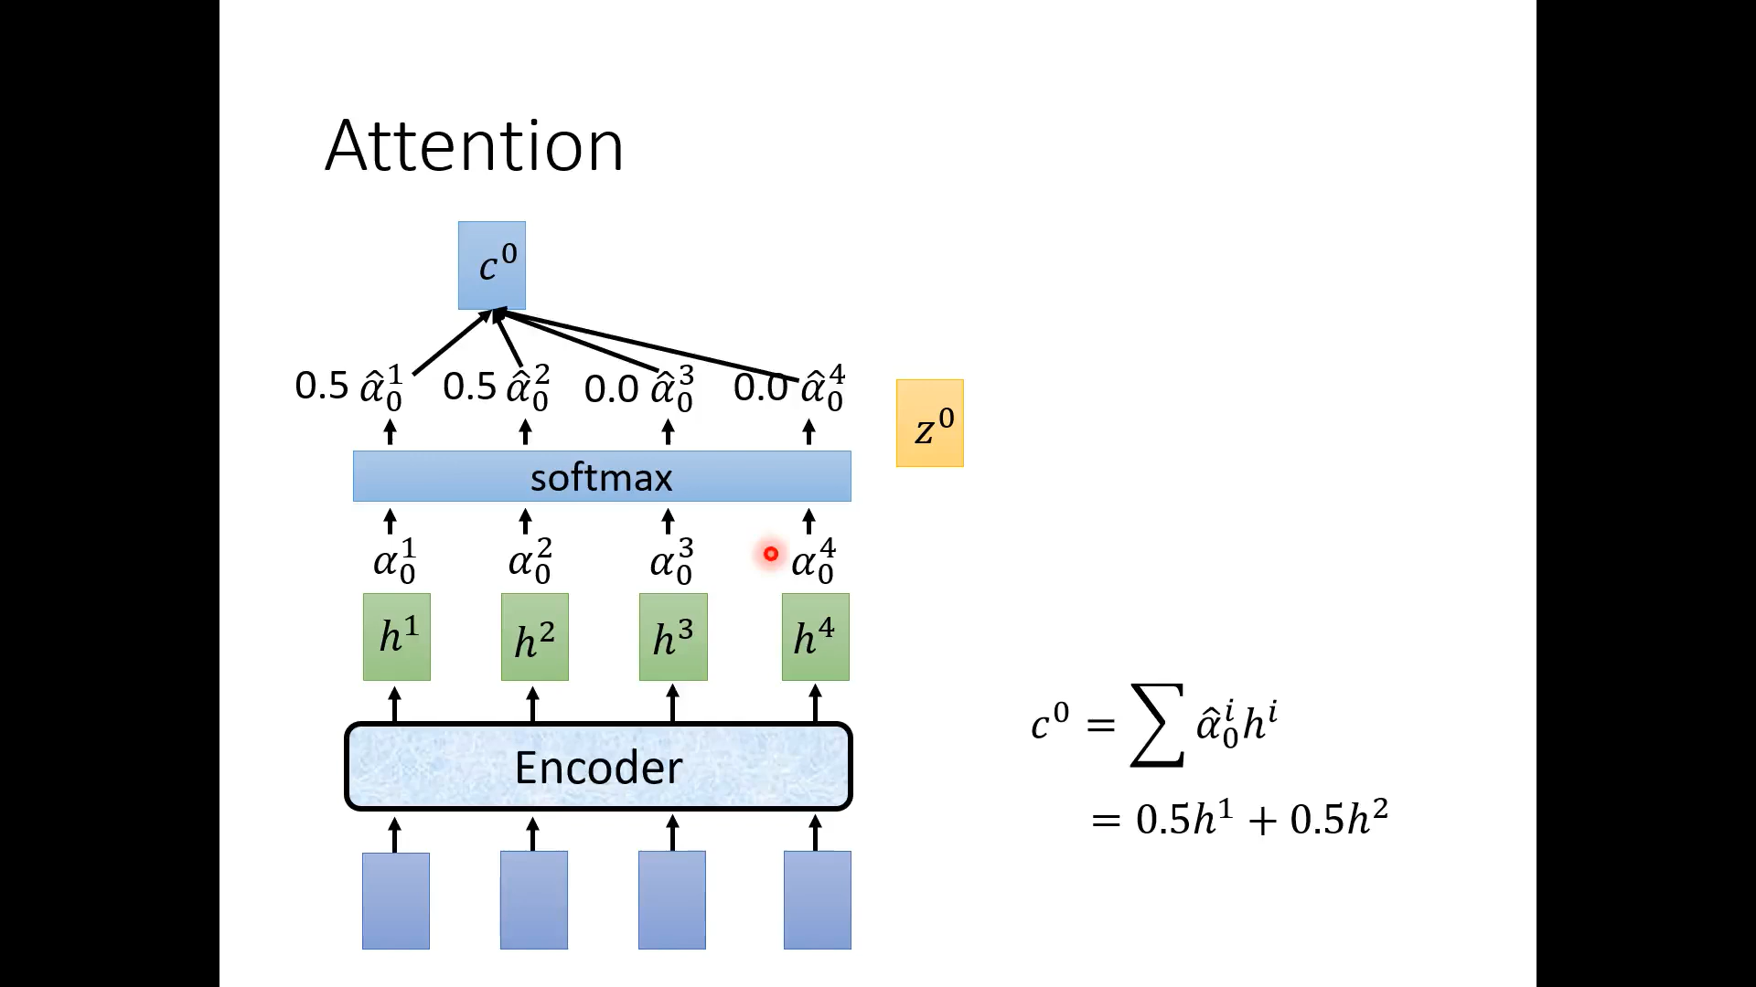

Slide 50
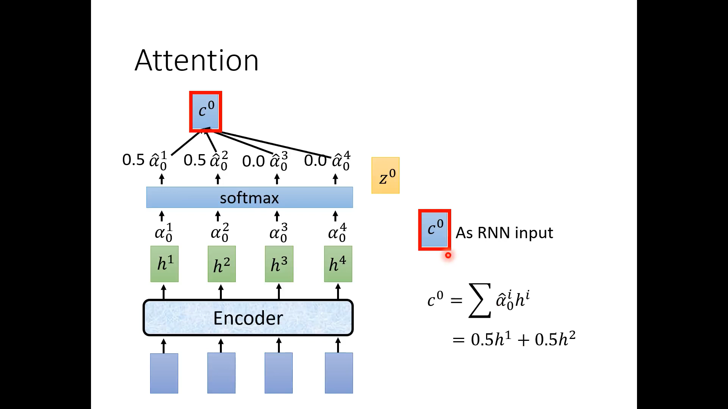

Slide 51
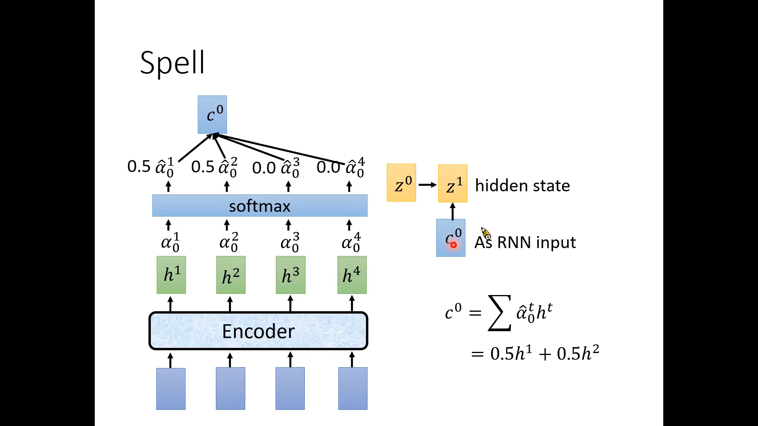

Slide 52
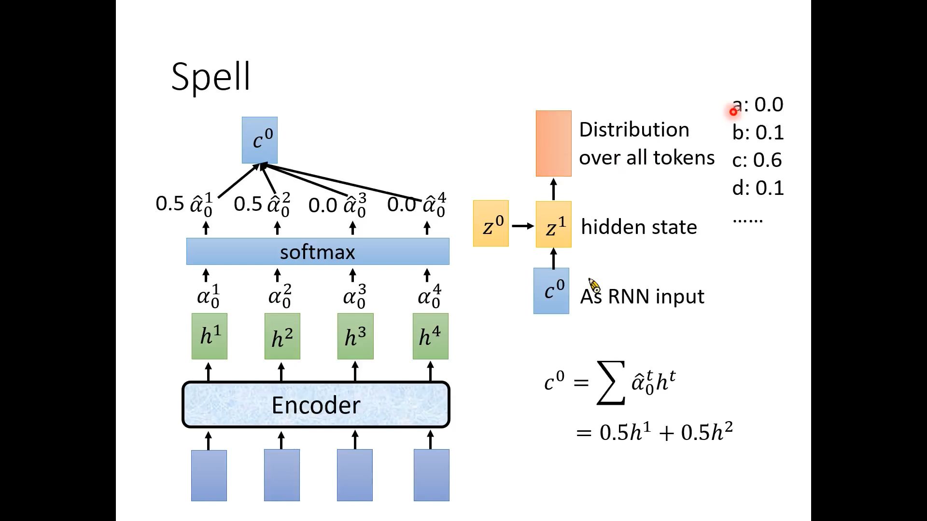

Slide 53
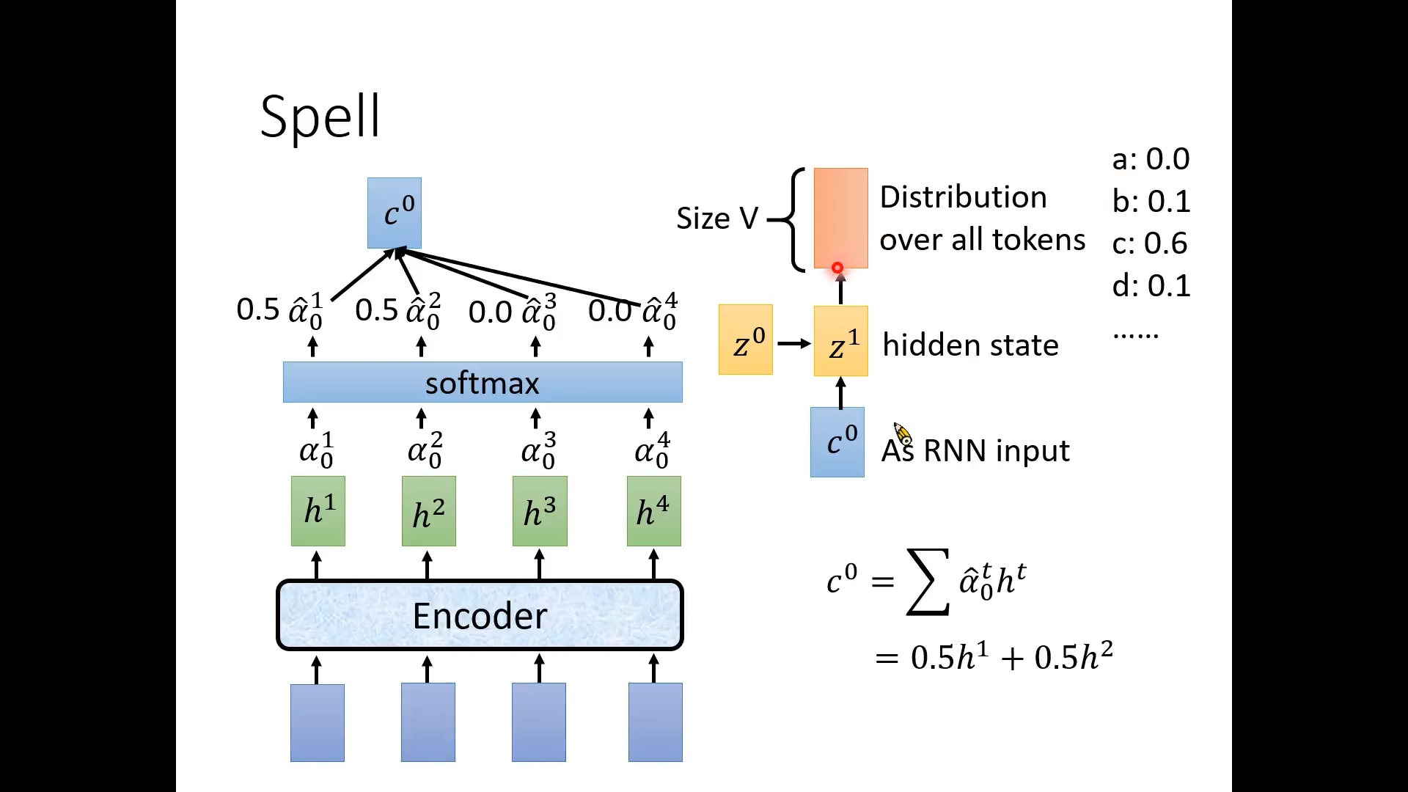

Slide 54


Slide 55


Slide 56


Slide 57


Slide 58


Slide 59


Slide 60


Slide 61


Slide 62


Slide 63


Slide 64


Slide 65


Slide 66


Slide 67


Slide 68


Slide 69


Slide 70


Slide 71


Slide 72


Slide 73


Slide 74


Slide 75


Slide 76


Slide 77


Slide 78


Slide 79


Slide 80


Slide 81


Slide 82


Slide 83


Slide 84


Slide 85
人工智能与听觉
语音基础
主要任务与基础方法
语音识别
音色转换
说话人分离
语音合成

Slide 87


Slide 88


Slide 89


Slide 90


Slide 91


Slide 92


Slide 93


Slide 94


Slide 95


Slide 96


Slide 97


Slide 98


Slide 99


Slide 100


Slide 101


Slide 102


Slide 103


Slide 104


Slide 105


Slide 106


Slide 107


Slide 108


Slide 109


Slide 110


Slide 111


Slide 112


Slide 113


Slide 114


Slide 115


Slide 116


Slide 117


Slide 118


Slide 119


Slide 120


Slide 121


Slide 122


Slide 123


Slide 124


Slide 125


Slide 126


Slide 127


Slide 128
人工智能与听觉
语音基础
主要任务与基础方法
语音识别
音色转换
说话人分离
语音合成

Slide 129


Slide 130


Slide 131


Slide 132


Slide 133


Slide 134


Slide 135


Slide 136


Slide 137


Slide 138


Slide 139


Slide 140


Slide 141


Slide 142


Slide 143


Slide 144


Slide 145


Slide 146


Slide 147


Slide 148


Slide 149


Slide 150


Slide 151


Slide 152


Slide 153


Slide 154


Slide 155


Slide 156


Slide 157


Slide 158


Slide 159


Slide 160


Slide 161


Slide 162
人工智能与听觉
语音基础
主要任务与基础方法
语音识别
音色转换
说话人分离
语音合成

Slide 164


Slide 165


Slide 166


Slide 167


Slide 168


Slide 169


Slide 170


Slide 171


Slide 172


Slide 173


Slide 174


Slide 175


Slide 176


Slide 177


Slide 178


Slide 179


Slide 180


Slide 181


Slide 182


Slide 183


Slide 184


Slide 185


Slide 187


Slide 188


Slide 189


Slide 190


Slide 191


Slide 192


Slide 193


Slide 194


Slide 195

Problem
End-to-end neural TTS has shown advantages over concatenative synthesis and statistical parametric synthesis
Production online model: Emphasis[1]/Tacotron[2]
SOTA model in research: Tacotron[2]/Transformer[3]
However, end-to-end neural TTS still suffers from the following problems
Slow inference speed: autoregressive mel-spectrogram generation is slow for long sequence;
Not robust: words skipping and repeating;
You can call me directly at 4257037344 or my cell 4254447474 or send me a meeting request with all the appropriate information.
[1] Li et al, EMPHASIS: An Emotional Phoneme-based Acoustic Model for Speech Synthesis System. InterSpeech 2018.
[2] Shen et al. Natural tts synthesis by conditioning wavenet on mel spectrogram predictions. ICASSP 2018.
[3] Li et al, Neural Speech Synthesis with Transformer Network. AAAI 2019.

Slide 196
Problem
End-to-end neural TTS has shown advantages over concatenative synthesis and statistical parametric synthesis
Production online model: Emphasis[1]/Tacotron[2]
SOTA model in research: Tacotron[2]/Transformer[3]
However, end-to-end neural TTS still suffers from the following problems
Slow inference speed: autoregressive mel-spectrogram generation is slow for long sequence;
Not robust: words skipping and repeating;
Lack of controllability: hard to control the voice speed and prosody in the autoregressive generation.
[1] Li et al, EMPHASIS: An Emotional Phoneme-based Acoustic Model for Speech Synthesis System. InterSpeech 2018.
[2] Shen et al. Natural tts synthesis by conditioning wavenet on mel spectrogram predictions. ICASSP 2018.
[3] Li et al, Neural Speech Synthesis with Transformer Network. AAAI 2019.

Slide 197
FastSpeech
Key improvements
Generate mel-spectrogram in parallel (for speedup)
Remove the attention mechanism between text and speech (for robustness)
Feed-forward transformer with length regulator (for controllability)
FastSpeech has the following advantages
Extremely fast: 270x inference speedup on mel-spectrogram generation, 38x speedup on voice generation!
Robust: no bad case of words skipping and repeating.
Controllable: can control voice speed and prosody.
Voice quality: on par or better than online/SOTA model.

Slide 198

Framework: Feed-Forward Transformer
Mel-spectrogram
(vocoder)
Phoneme ----> Mel-spectrogram -----> Voice
Feed-forward transformer: generate mel-spectrogram in parallel both in training and inference (speedup)
Remove the attention mechanism between text and speech (robustness)
Length Regulator: bridge the length mismatch between phoneme and mel sequence (controllability)

Slide 199

Framework: FFT block
FFT (Feed-Forward Transformer) block: basic block from Transformer, stack N layers.
Replace dense connection with 1D convolution in speech problem.
Share the same model structure between the phoneme side and mel side.

Slide 200


Framework: Length Regulator
speech
1.0x speed
s p iy ch
=1
2 2 3 1
s s p p iy iy iy ch
= 0.5 (1 1 1.5 0.5 → 1 1 2 1)
2.0x speed
s p iy ch
2 2 3 1
s p iy iy ch
0.5x speed
s p iy ch
= 2 (4 4 6 2)
2 2 3 1
s s s s p p p p iy iy iy iy iy iy ch ch

Slide 201

Framework: Duaration Predictor
2 2 3 1
How to get the label to train the duration predictor?
Extract duration based on the attention alignments from the autoregressive teacher
2 2 3 1

Slide 202

Framework: Feed-Forward Transformer

Slide 203

Inference speedup
270x speedup for mel-spectrogram generation!
38x speedup for voice synthesis!

Slide 204

Robustness
Test on 50 extremely hard sentences provided by TTS team
FastSpeech has no repeating, skipping and error sentences
Transformer TTS
FastSpeech
You can call me directly at 4257037344 or my cell 4254447474 or send me a meeting request
with all the appropriate information.
Http0XX , Http1XX , Http2XX , Http3XX

Slide 205


Controllability
Voice Speed Control
Prosody Control
For a while the preacher addresses himself to the congregation at large, who listen attentively.
after dinner | he went into hiding for a day or two.

Slide 206

Speech synthesis quality
FastSpeech achieves comparable voice quality with Tacotron2 and Transformer TTS, and is close to ground-truth recordings.
https://speechresearch.github.io/fastspeech/

Slide 207

AdaSpeech 4: Adaptive Text to Speech in Zero-Shot Scenarios

Slide 208
人工智能与听觉
语音基础
主要任务与基础方法
语音识别
音色转换
说话人分离
语音合成

Slide 209
参考书目
李宏毅, 《深度学习与人类语言处理》
https://www.bilibili.com/video/BV1RE411g7rQ?p=14
Ren et al., FastSpeech: Fast, Robust and Controllable Text to Speech, NeurIPS 2019
Ren et al., FastSpeech 2: Fast and High-Quality End-to-End Text to Speech, ICLR 2021

Slide 210
谢谢

